Slide 1
Interactive data visualization in Python using Bokeh Library
Sundas Munir – Doctoral Student
Course - Introduction to Research in Embedded and Intelligent Systems
Email: Sundas.munir@hh.se

Slide 2
Contents
Learning Goal
Driving Scenarios
Driving Scenarios Visualization in Vista
Vista and Reachability Analysis
Python - Bokeh Library
Plotting of Reachable and Unsafe Regions

Slide 3

Learning Goal
You’ll learn how to
  Transform the data into visualization, using Bokeh library
  Customize and organize the visualizations
  Add interactivity to the visualizations
  Running the Bokeh server to examine the static HTML page of the application

Slide 4
Driving Scenarios
Driving scenarios consist of
  Paths
  Vehicles
  Actions
Paths: Connected waypoints i.e. drivable area
Vehicles: Control model of vehicle defining maximum speed, acceleration time, steering angles, etc.
Actions: defines a vehicle ‘v’ driving on path ‘p’ starting from ‘x%’ of path to ‘y%’ with speed ‘s’. In short actions define the trajectory along with other values.

Slide 5
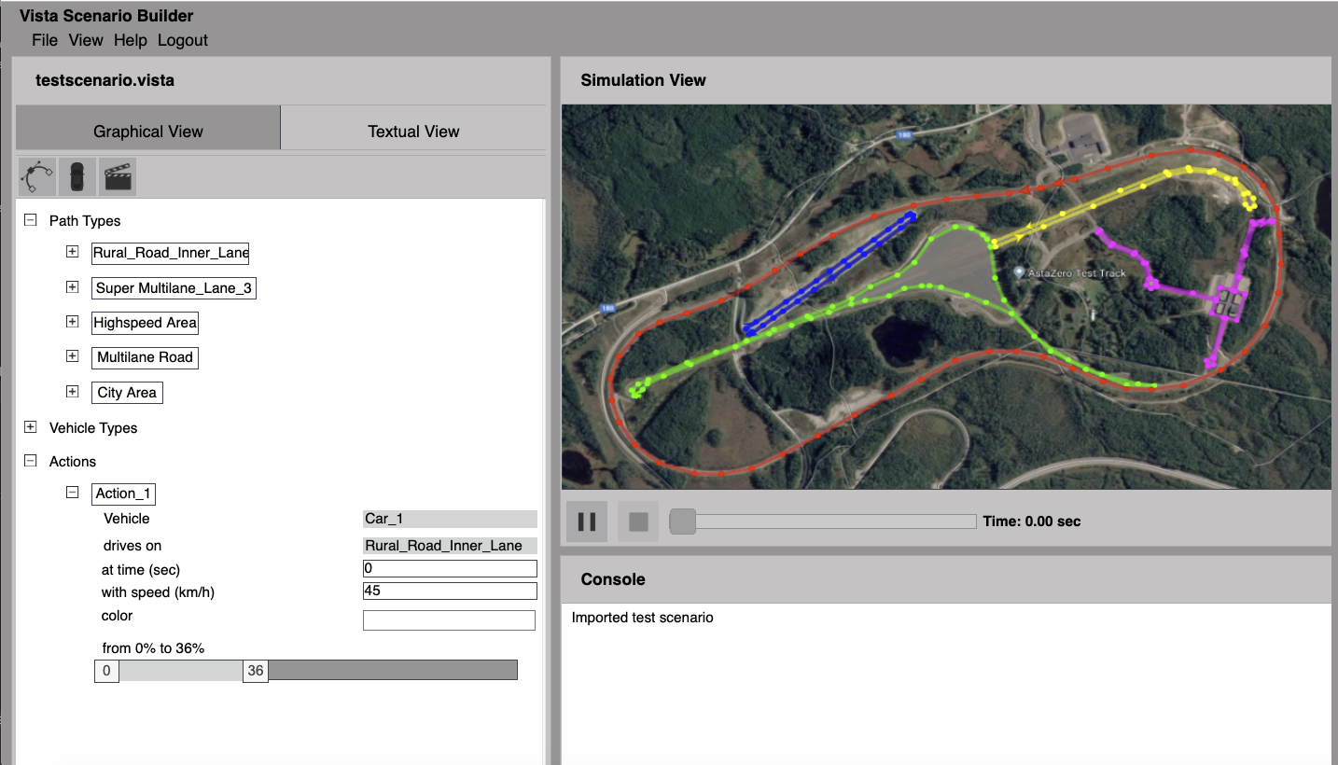
Driving Scenarios Visualization in Vista
Vista is a web-based tool to perform analysis and visualization of reachable sets in automotive safety domain
Driving scenarios can be defined either graphically or with textual language
Vista uses JavaScript for analysis related calculations and BabylonJS engine for visualizations

Slide 6
Vista and Reachability Analysis
Unsafe regions are areas with possible or actual collision between vehicles driving under defined actions.
Forward Reachable Sets and Unsafe Regions: are calculated based on uncertainties
  Geometry, control model of vehicle, kinematic model of vehicle, model of dynamics,

Slide 7
Python - Bokeh Library
Bokeh is an interactive visualization library for modern web browsers.
provides elegant, concise construction of versatile graphics, and affords high-performance interactivity over large or streaming datasets.
Bokeh renders its graphics using HTML and JavaScript – Great for building web-based dashboards and applications with interactive plots
In Python we will import JSON file compiled from Vista and visualize all the regions using Bokeh library

Slide 8
From Data to Visualization
Building a visualization with Bokeh involves the following steps:
  Preparing the data
  Determining where the visualization will be rendered (static HTML in this example)
  Setting up the figure(s) for the plot
  Drawing the data and enable interaction
  Organizing the layout for HTML document
  Running Bokeh server to launch static HTML page

Slide 9
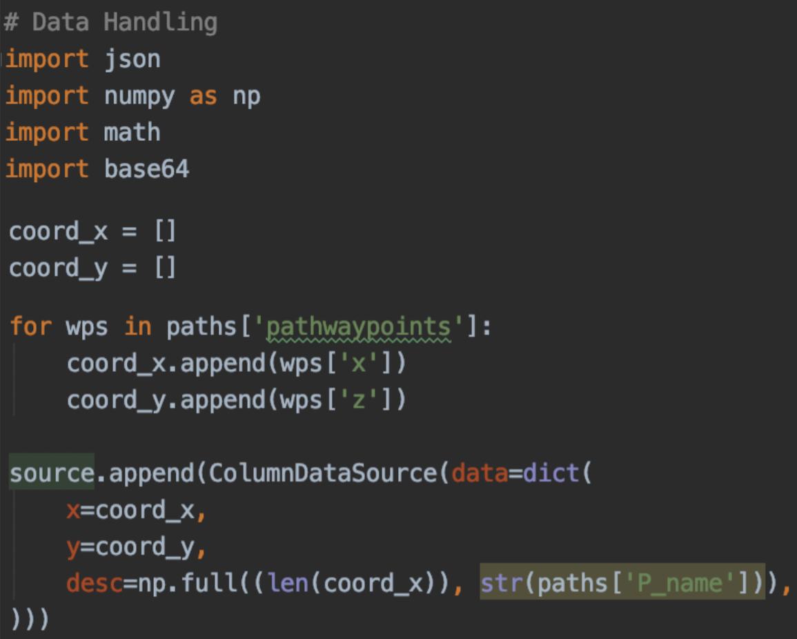
From Data to Visualization - Data
Preparing the Data
  Data for this example is in the form of JSON files compiled from Vista.
  Waypoints are represented as (x,y) coordinates and path is connected line between waypoints
  Reachable and Unsafe regions are contained in the JSON file in form of sets.

Slide 10
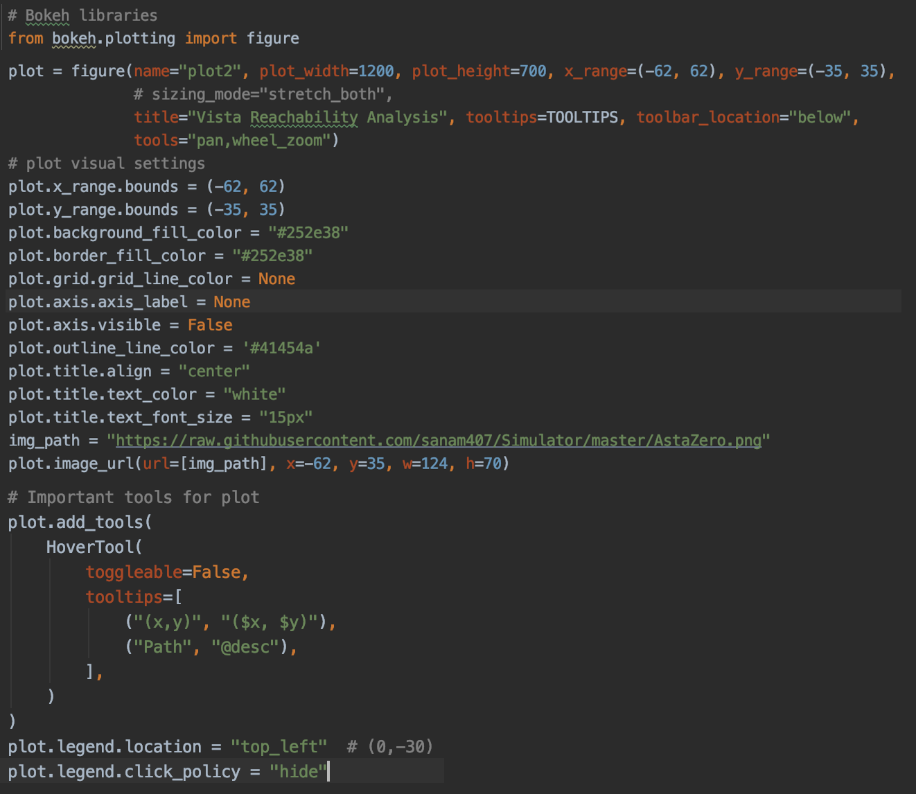
From Data to Visualization – Figure(s) for plot
Set up the Figure(s)
  assembling the figure,
  preparing the canvas for visualization
  Customization of everything from grid size, background color, background image, border color and visibility, title, and axis visibility etc.

Slide 11
From Data to Visualization – Draw Plot
Draw Your Data
  Bokeh provides multitude of renderers to give shape to the data.
  incredible creative freedom in representing the data.
  Lots of supported glyphs
    Markers: including circle, square, cross, triangle and more
    Line: single, step and multi-line shape
    Bar/Rectangle: traditional or stacked bar (hbar) and column (vbar) charts as well as waterfall or gantt charts.
  Bokeh has some built-in functionality for building things like stacked bar charts and plenty of examples for creating more advanced visualizations like network graphs and maps.

Slide 12
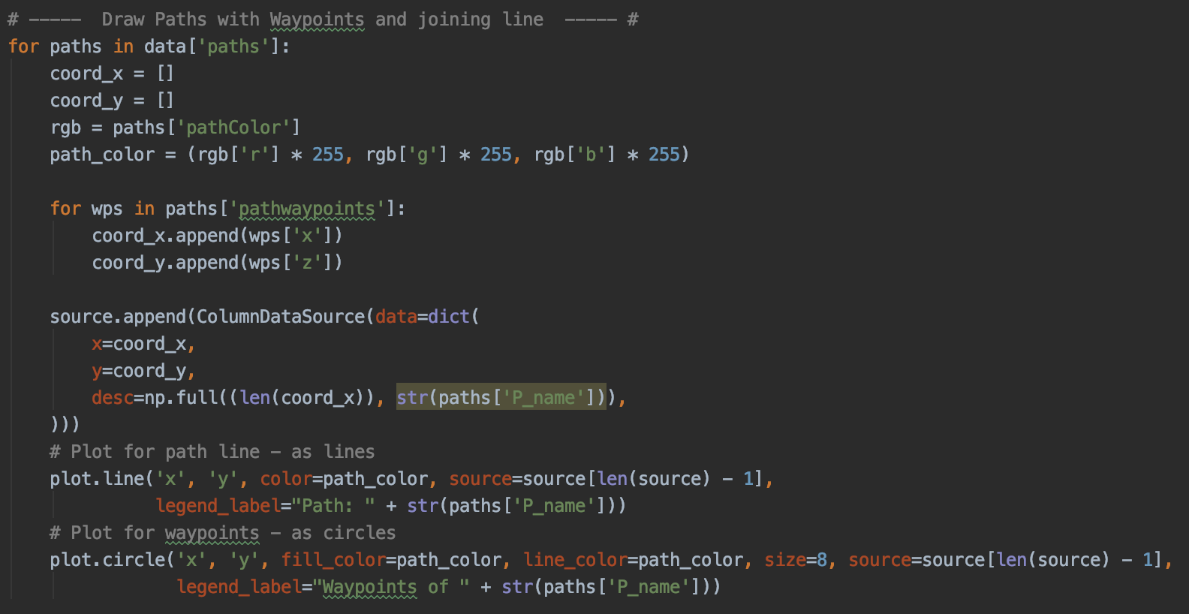
From Data to Visualization – Draw Plot

Slide 13
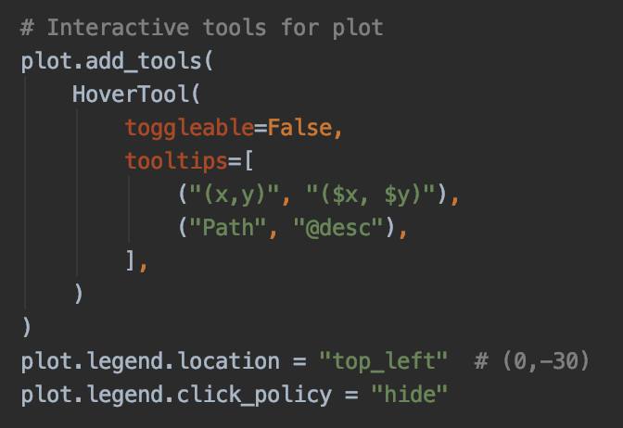
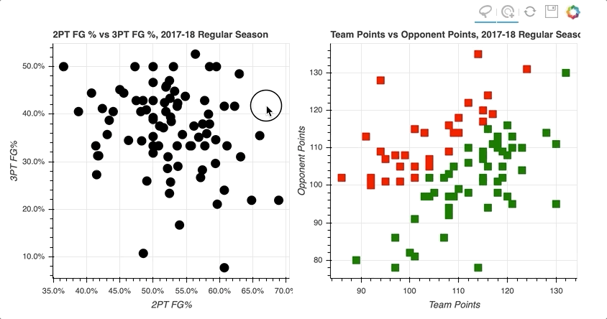
From Data to Visualization – Enable interaction
Interactive Plots
  Numerous options for interaction with data with options such as hover actions, click policy, etc

Slide 14
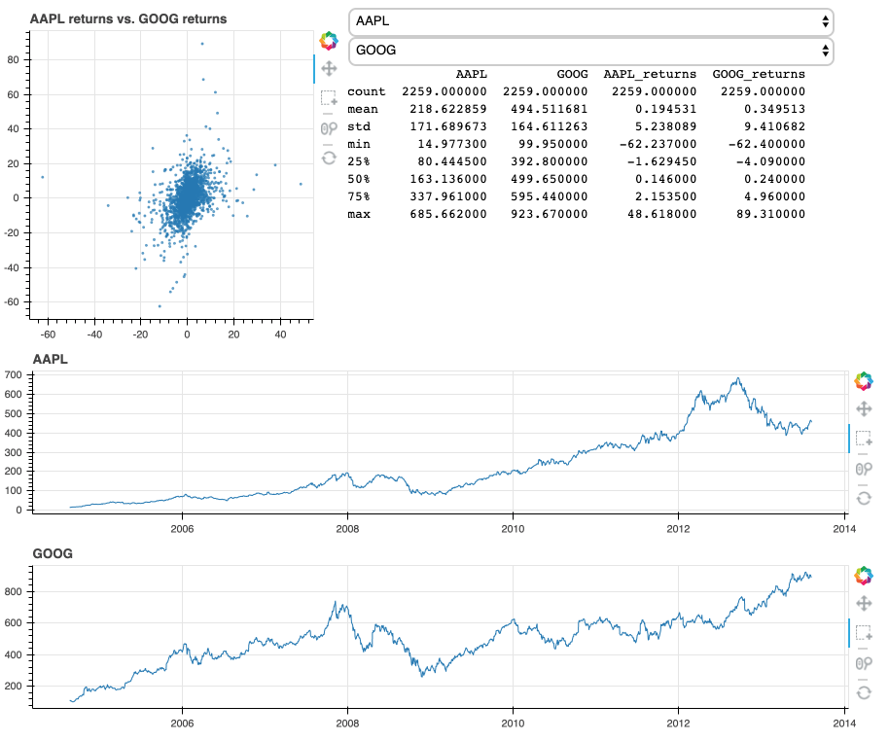
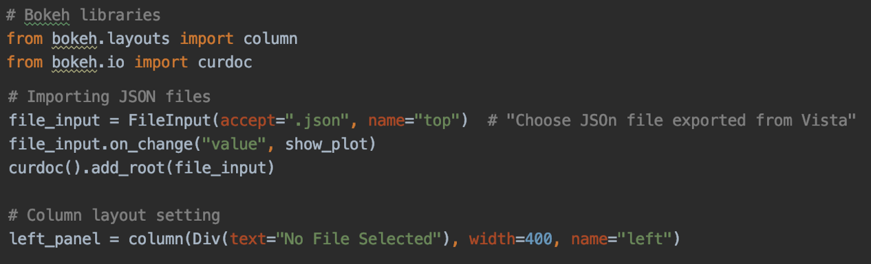
From Data to Visualization – widgets & Layouts
Widgets
  Buttons, input fields, dropdowns, etc. Pretty much everything required for a web page
Organize the Layout
  Grid layout, layout, layout for connecting and linking multiple graphs

Slide 15
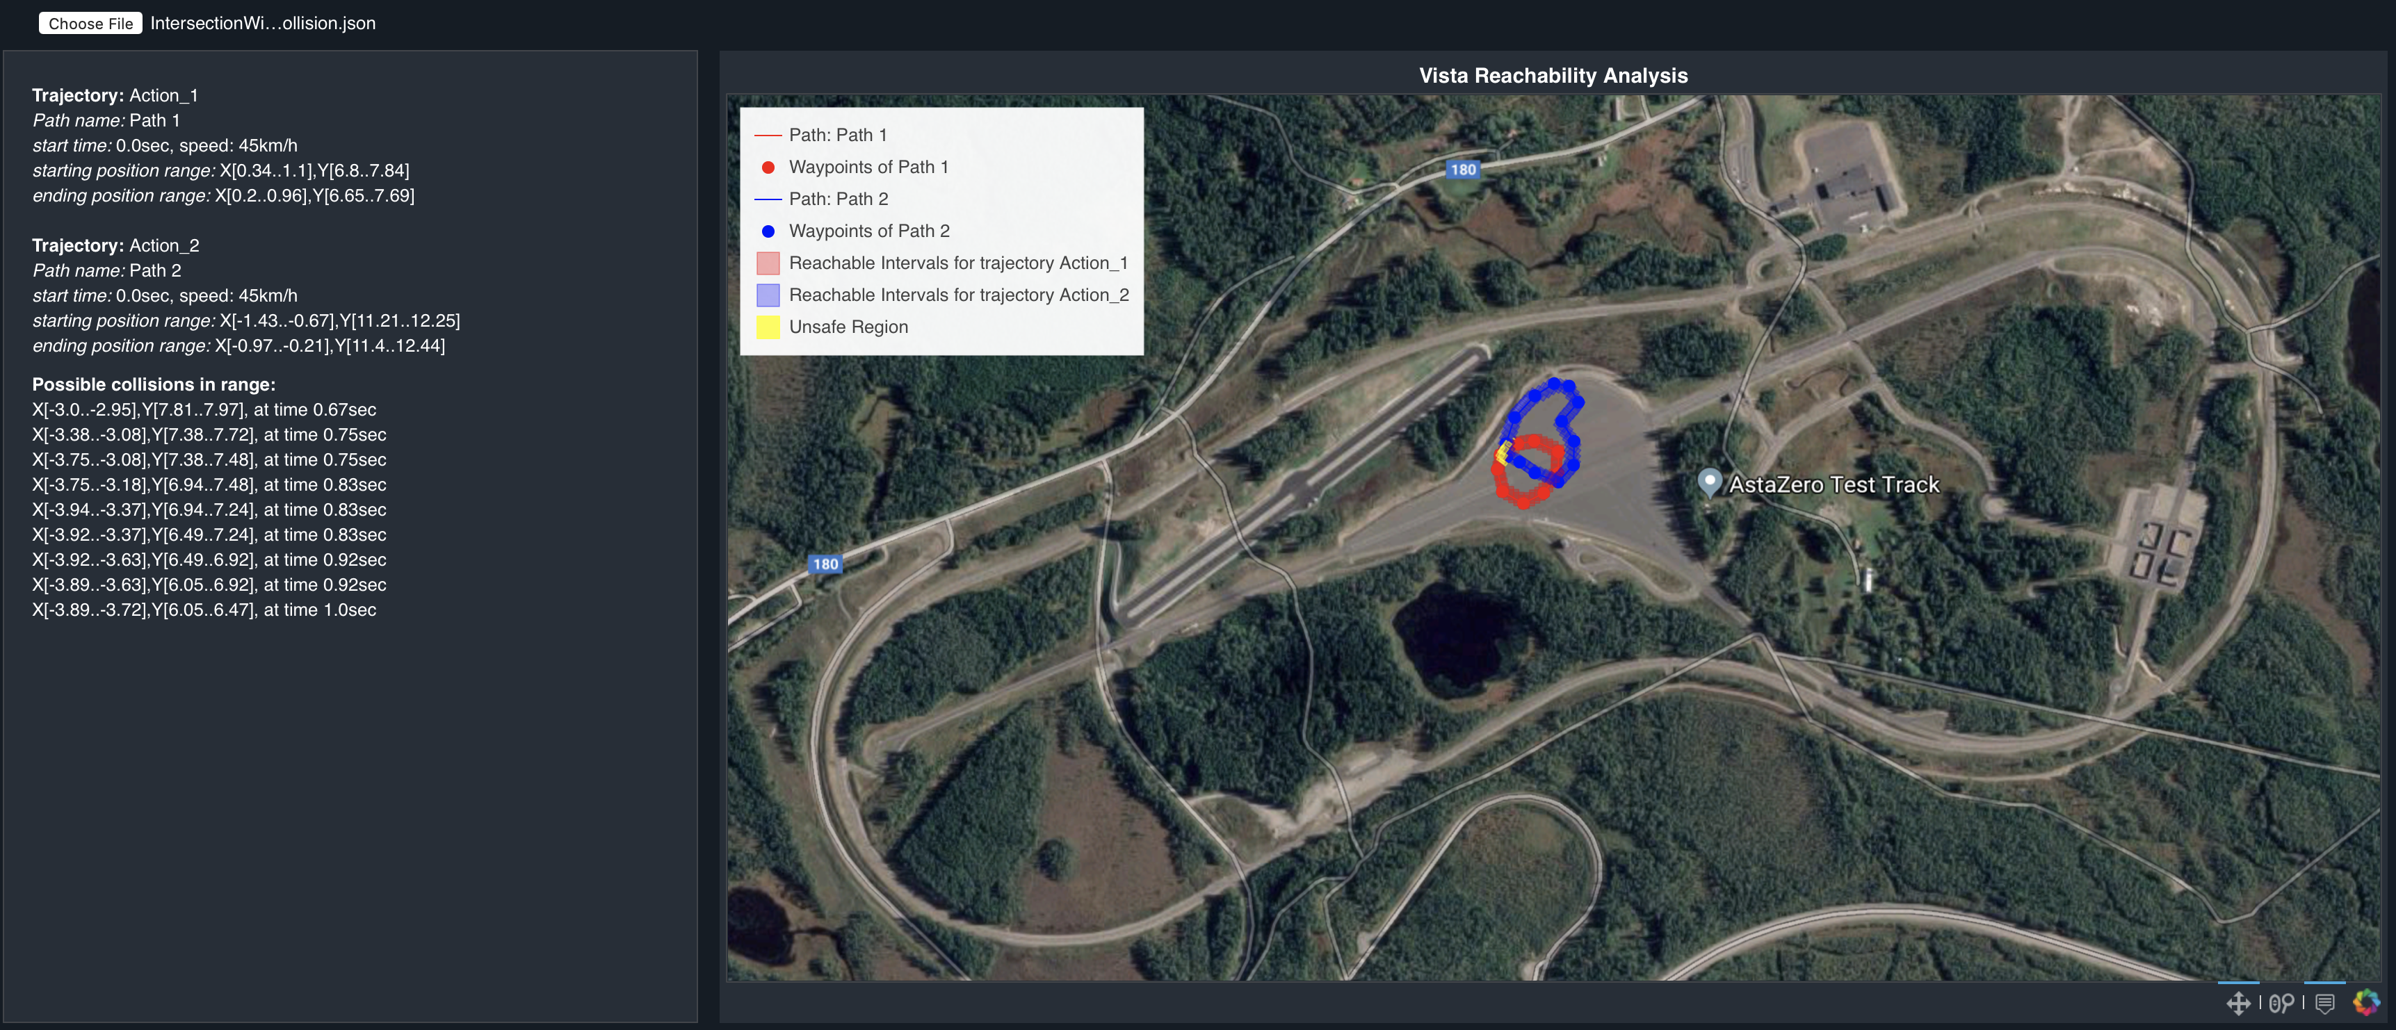
Plotting of Reachable and Unsafe Regions
We draw three kind of plots on top of each other
  Paths (Connected lines through waypoints)
  Reachable Regions – box shape sets representation
  Unsafe Regions– box shape sets representation
We show details in form of text on left column
This is how the end result look like

Slide 16
Useful links
Refer to Bokeh installation guide
  Install bokeh using commands “conda install bokeh” OR “pip install bokeh”
  “sudo easy_install pip”, if pip command not found.
Download sample code from Github respository
Run the Bokeh server – “Bokeh serve –show Vista”
A simple tutorial to learn more about Bokeh: https://realpython.com/python-data-visualization-bokeh/

Slide 17
Questions?

