Slide 1
TensorFlow Hands On
Nesma Rezk
Doctoral Student
Python Course
23-11-2017

Slide 2

Tensorflow
In TensorFlow, a computation is described using the Data Flow Graph
Each node in the graph represents the instance of a mathematical operation
Each edge is a multi-dimensional data set (tensors) on which the operations are performed.

Slide 3
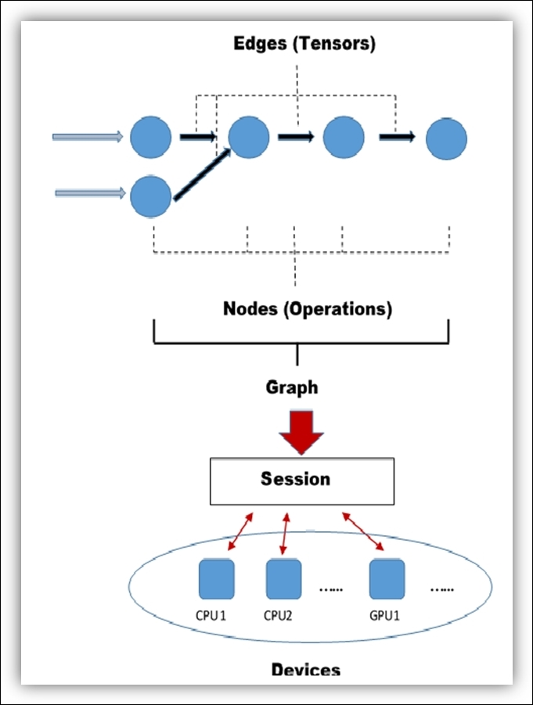
Nodes
Node: In TensorFlow, each node represents the instantiation of an operation
Operation: abstract computation
Matrix multiply
Add
….
Attributes: possible to make operations polymorphic over different tensor element types

Slide 4
Edges
Edges: In TensorFlow, there are two types of edge:
Normal Edges: They are carriers of data structures (tensors), where an output of one operation (from one node) becomes the input for another operation.
Special Edges: A control dependency between two nodes. Let's suppose we have two nodes A and B and a special edges connecting A to B; it means that B will start its operation only when the operation in A ends.

Slide 5
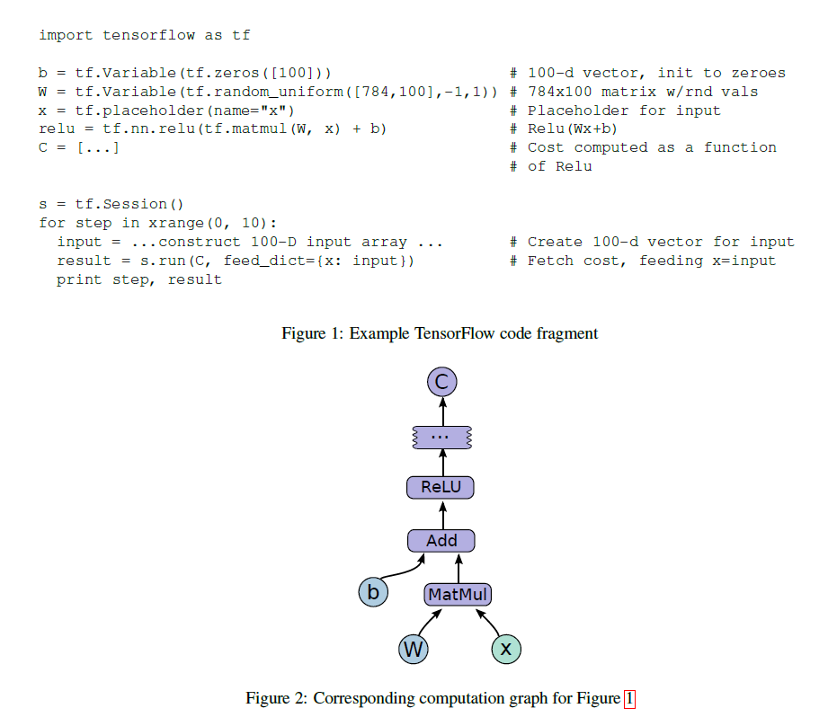
Sessions
Graph is initially empty
Session builds the graph
Run feeds the tensor through graph to compute outputs

Slide 6
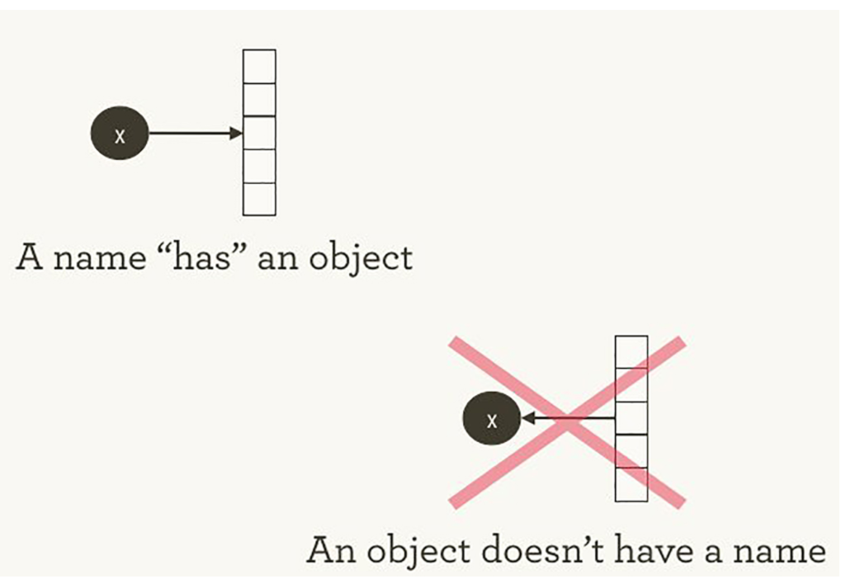
Names and Execution
As in Python,

Slide 7
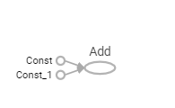
Names and Execution
In Python:
a=2
b=3
x=a+b
print(x)
5
In TensorFlow:
Tensor("Add:0", shape=(), dtype=int32)
a = tf.constant(2)
b = tf.constant(3)
x = tf.add(a, b)
print(x)
Running a session:
with tf.Session() as sess:
print (sess.run(x))
5

Slide 8
Let’s start getting our hands dirty
Visit the installation link and install TensorFlow
https://www.tensorflow.org/install/

Slide 9
Graphs
with tf.Session() as sess:
writer = tf.summary.FileWriter('./graphs', sess.graph)
writer.close()

Slide 10
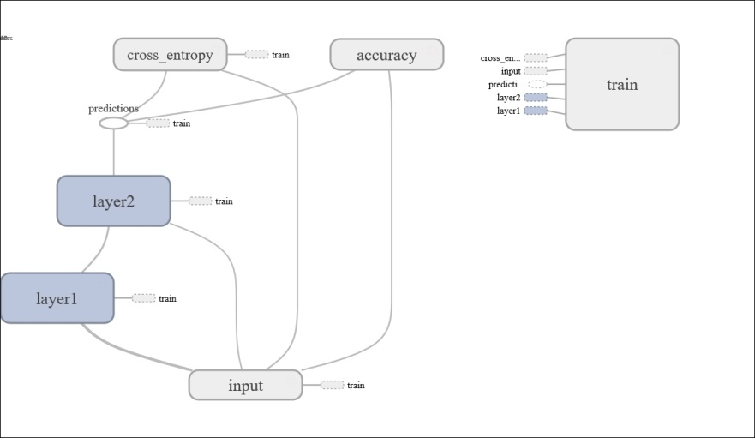
Tensor Board
TensorBoard is a visualization tool, devoted to analyzing Data Flow Graph and also to better understand the machine learning models
TensorBoard collapses nodes in high-level blocks, highlighting the groups with identical structures.

Slide 11
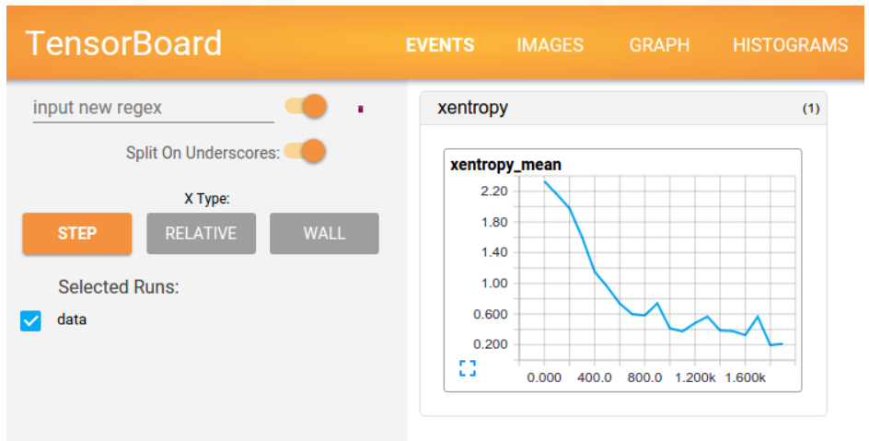
Tensorboard

Slide 12
TensorBoard
Run the command
tensorboard --logdir=./graphs --port 6006
Or run it from python
Import os
os.system('tensorboard --logdir=./graphs --port 6006' )
navigate your web browser to
localhost:6006 →in my case:http://ITE11879:6006

Slide 13
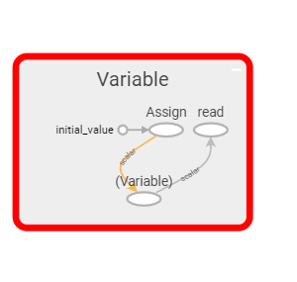
Constants Vs Variables
What happens to the graph when we add the line
weight = tf.Variable(0.8)

Slide 14
Working With Variables
Try to multiply and print the output
a = tf.constant(2.0)
weight = tf.Variable(0.8)
output_value = tf.multiply(a,weight)
Is there a problem?!!!
sess.run(tf.global_variables_initializer())

Slide 15
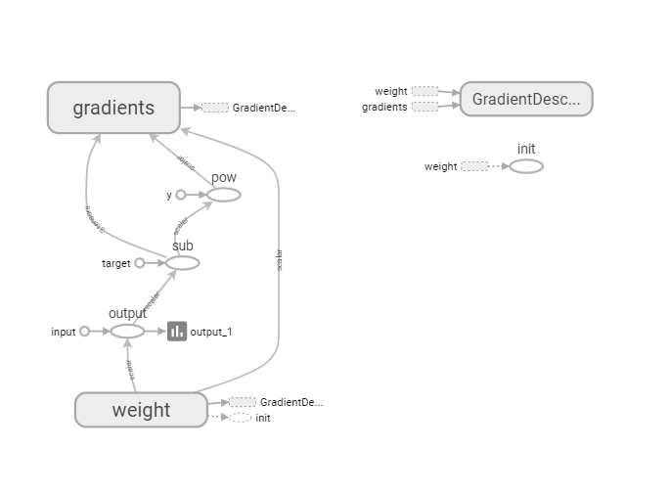
Training

Slide 16
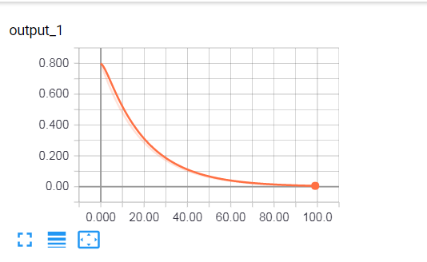
Plotting the training

Slide 17
Resources
TensorFlow Official Website
www.tensorflow.org
TensorFlow white paper
TensorFlow: Large-Scale Machine Learning on Heterogeneous Distributed Systems
Aaron Schumacher tutorial
www.oreilly.com/learning/hello-tensorflow

Slide 18
Thank you!

