Slide 1
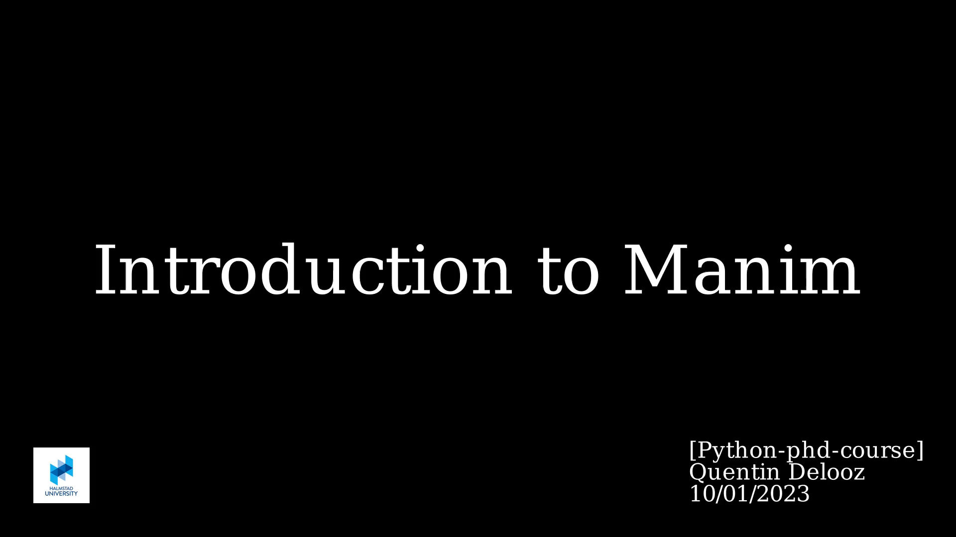

Slide 2
Overlook
What is Manim?
What can you do with it?
How does it work?
Small tutorial
Why bother?
Useful links

Slide 3
What is Manim?
Python library: https://github.com/3b1b/manim
Engine for precise programmatic animations, designed for creating explanatory math videos

Slide 4
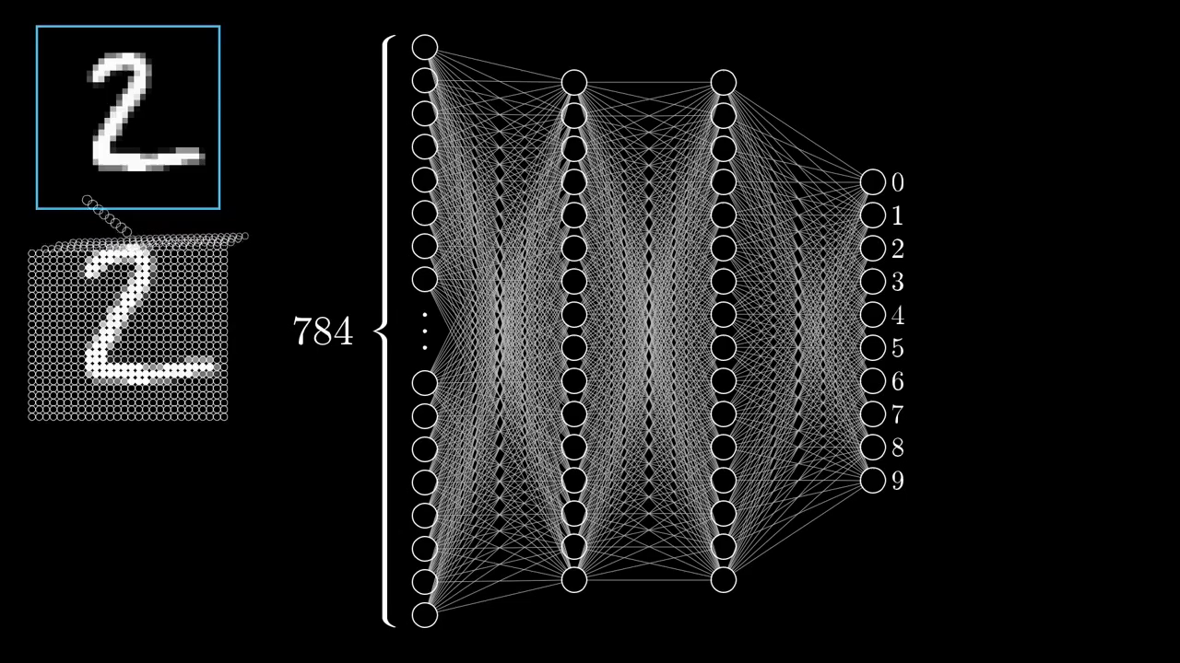

Slide 5
What is Manim?
Developed initially by the youtuber Grant Sanderson “3Blue1Brown”
Then updated and maintained by community
Manim
Manim Community
Better maintained & documented

Slide 6
What can you do with it?
A lot ☺
Let’s underline some of its features..

Slide 7

Change colours ☺

Slide 8

.. And Fonts

Slide 9

Latex Interpreter

Slide 10
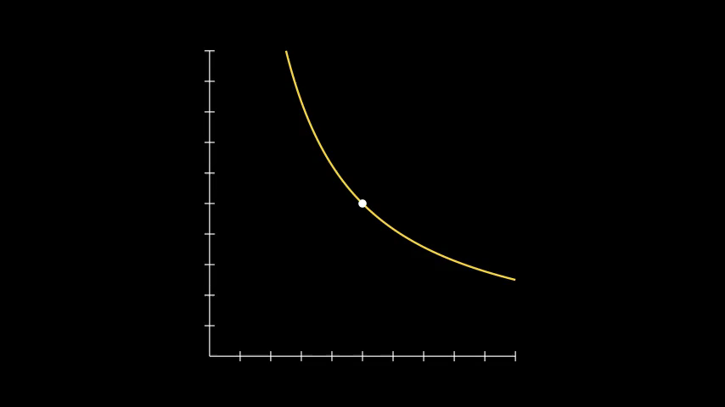
Plot Functions

Slide 11
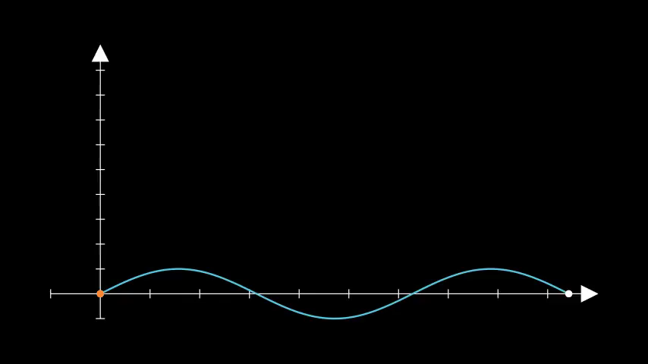
Plot Functions… and More

Slide 12

Plugin “ManimML”

Slide 13

Plugin “Automata”

Slide 14

Plugin “Manim CAD”

Slide 15

Plugin “Code-Blocks”
Notes:
https://github.com/NicholasIapalucci/Manim-Code-Blocks

Slide 16
Plugin “Data Structures”
Notes:
https://github.com/NicholasIapalucci/Manim-Code-Blocks

Slide 17
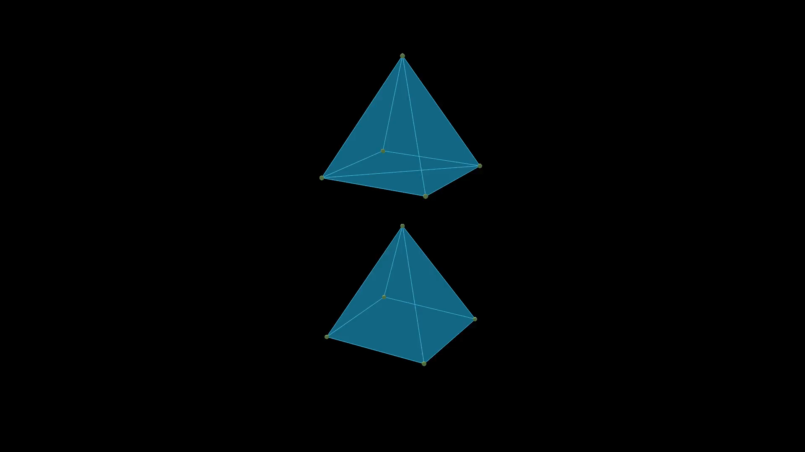
Plugin “Meshes”
Notes:
https://github.com/NicholasIapalucci/Manim-Code-Blocks

Slide 18
Plugin “Chanim”
Notes:
https://github.com/NicholasIapalucci/Manim-Code-Blocks

Slide 19
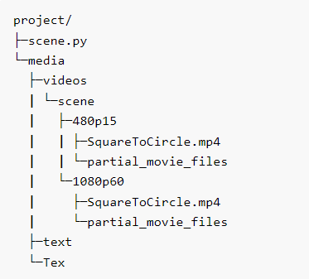
How does it work?
Scene to animate
No direct call to python
manim -pql scene.py SquareToCircle
p: play when done
ql: low quality (possible ql/qm/qh/qk)

Slide 20
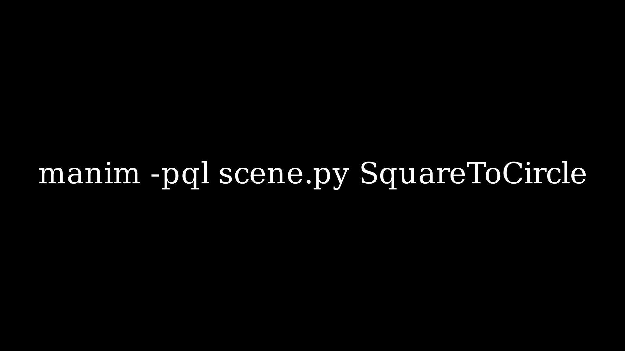
How does it work?

Slide 21
How does it work?
Building blocks:
  Mathematical Object (mobject)
  Animation
  Scene

Slide 22
Mathematical Object (mobject)
Mobject = object to display on the screen
Mobject is an abstract class -> all objects on a display inheritate from this class
Example: Circle, Arrow, BarChart, …

Slide 23
Animation
Animations are procedures that interpolate between two mobjects

Slide 24
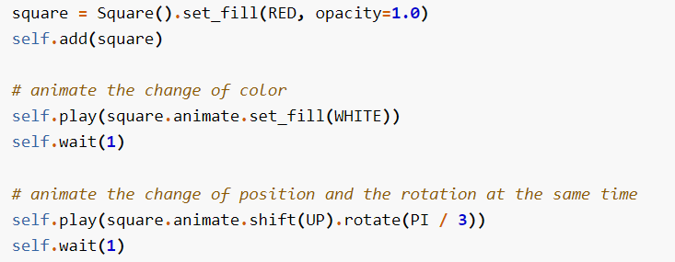
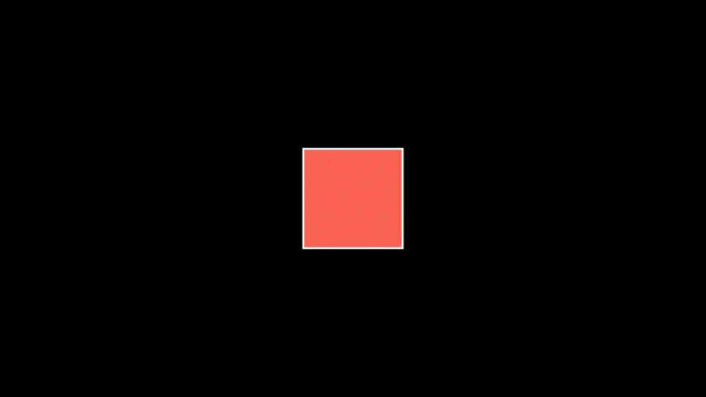
Animation
Default 1 second duration!

Slide 25
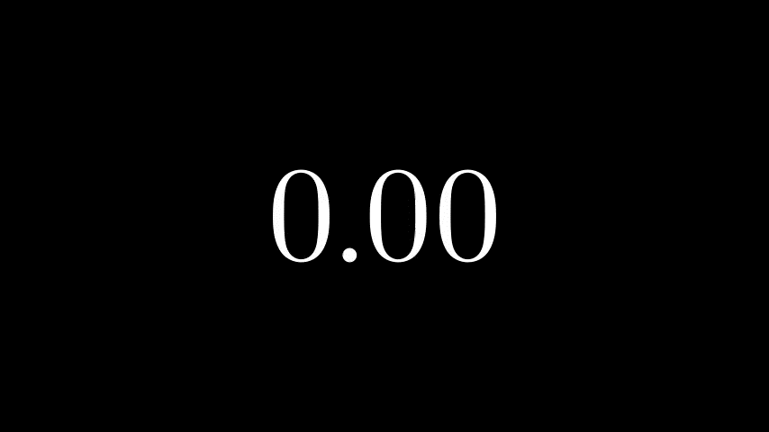
Custom Animation
Receipt:
  Extend the “Animation” class
  Override the function “interpolate_mobject()”
    This function is called with the parameter « alpha »
    « alpha » holds a value between 0 and 1 representing the step of the currently playing animation.
    You can chose what to print for each value of alpha

Slide 26
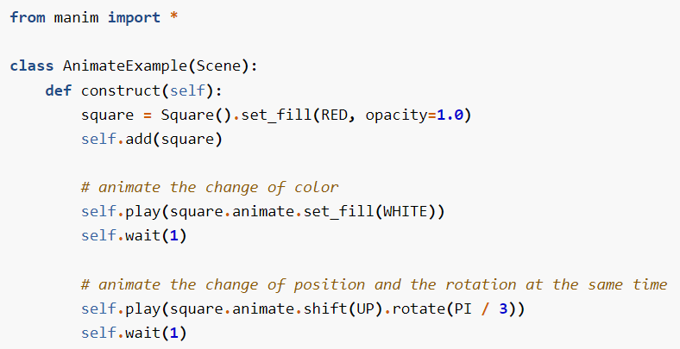
Scene
The Scene class is the connective tissue of manim
All code is usually in the function “construct” of a scene
Each mobject should be added to the scene
Every animation hast to be played by a scene
Can use wait() function to stop an animation
Can have multiple scenes in a file and can be rendered at the same time

Slide 27

Tutorial
Jupyter Notebook: https://try.manim.community/
In case you want it directly on your computer: https://docs.manim.community/en/stable/installation.html
Challenge? Realize:

Slide 28
Why Bother?
Can we use ChatGPT to realize some animations?

Slide 29
Conclusion
Like everything, should not be abused
Time-consuming to realize an animation (ChatGpt can help!)
Not always so intuitive to work in the documentation
But good animations!

Slide 30
Useful Links
https://www.manim.community/
https://www.3blue1brown.com/
https://plugins.manim.community/
https://www.youtube.com/@3blue1brown

