Slide 1

Generative Programming Meets Constraint Based Synthesis
Armando Solar-Lezama
Notes:
Over the last few days, we have seen several different applications of synthesis for what could collectively be called Quality Control

Slide 2
Example
You want to partition N elements over P procs
How many elements should a processor get?
Obvious answer is N/P
Obvious answer is wrong!
N = 18
P = 5

Slide 3
Synthesizing a partition function
What do we know?
The interface to the function we want
Not all processors will get the same # of elements
The kind of expressions we expect
void partition(int p, int P, int N, ref int ibeg, ref int iend){
if(p< expr({p, P, N, N/P, N%P},{PLUS,TIMES}) ){
iend = expr({p, P, N, N/P, N%P},{PLUS,TIMES});
ibeg = expr({p, P, N, N/P, N%P},{PLUS,TIMES});
}else{
iend = expr({p, P, N, N/P, N%P},{PLUS,TIMES});
ibeg = expr({p, P, N, N/P, N%P},{PLUS,TIMES});
}
}
N
P
N%P
*
+
p
N/P

Slide 4
Synthesizing a partition function
How does the system know what a partition is?
harness void testPartition(int p, int N, int P){
if(p>=P || P < 1){ return; }
int ibeg, iend;
partition(p, P, N, ibeg, iend);
assert iend - ibeg < (N/P) + 2;
if(p+1 < P){
int ibeg2, iend2;
partition(p+1, P, N, ibeg2, iend2);
assert iend == ibeg2;
}
if(p==0){ assert ibeg == 0; }
if(p==P-1){ assert iend == N; }
}
Partitions should be balanced
Adjacent partitions should match
First and last partition should go all the way to the ends

Slide 5
Language Design Strategy
Extend base language with one construct
Constant hole: ??
Synthesizer replaces ?? with a constant
High-level constructs defined in terms of ??
int bar (int x)
{
int t = x * ??;
assert t == x + x;
return t;
}
int bar (int x)
{
int t = x * 2;
assert t == x + x;
return t;
}

Slide 6
Integer Holes → Sets of Expressions
Expressions with ?? == sets of expressions
linear expressions x*?? + y*??
polynomials x*x*?? + x*?? + ??
sets of variables ?? ? x : y
Semantically powerful but syntactically clunky
Regular Expressions are a more convenient way of defining sets

Slide 7
Regular Expression Generators
{| RegExp |}
RegExp supports choice ‘|’ and optional ‘?’
can be used arbitrarily within an expression
to select operands {| (x | y | z) + 1 |}
to select operators {| x (+ | -) y |}
to select fields {| n(.prev | .next)? |}
to select arguments {| foo( x | y, z) |}
Set must respect the type system
all expressions in the set must type-check
all must be of the same type

Slide 8
Generators
Look like a function
but are partially evaluated into their calling context
Key feature:
Different invocations → Different code
Can recursively define arbitrary families of programs

Slide 9
Example: Least Significant Zero Bit
0010 0101 → 0000 0010
Trick:
Adding 1 to a string of ones turns the next zero to a 1
i.e. 000111 + 1 = 001000
int W = 32;
bit[W] isolate0 (bit[W] x) { // W: word size
bit[W] ret = 0;
for (int i = 0; i < W; i++)
if (!x[i]) { ret[i] = 1; return ret; }
}

Slide 10
Sample Generator
/**
* Generate the set of all bit-vector expressions
* involving +, &, xor and bitwise negation (~).
* the bnd param limits the size of the generated expression.
*/
generator bit[W] gen(bit[W] x, int bnd){
assert bnd > 0;
if(??) return x;
if(??) return ??;
if(??) return ~gen(x, bnd-1);
if(??){
return {| gen(x, bnd-1) (+ | & | ^) gen(x, bnd-1) |};
}
}

Slide 11
Example: Least Significant Zero Bit
generator bit[W] gen(bit[W] x, int bnd){
assert bnd > 0;
if(??) return x;
if(??) return ??;
if(??) return ~gen(x, bnd-1);
if(??){
return {| gen(x, bnd-1) (+ | & | ^) gen(x, bnd-1) |};
}
}
bit[W] isolate0sk (bit[W] x) implements isolate0 {
return gen(x, 3);
}

Slide 12
A Constraint based synthesis primer

Slide 13
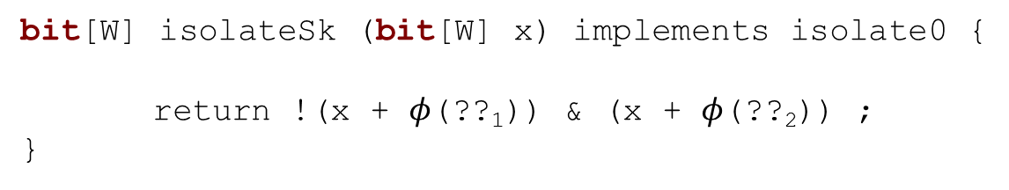
Framing the synthesis problem
Goal: Find a function from holes to values
Easy in the absence of generators
Finite set of holes so function is just a table
bit[W] isolateSk (bit[W] x) implements isolate0 {
return !(x + $φ$(??₁)) & (x + $φ$(??₂)) ;
}
bit[W] isolateSk (bit[W] x) implements isolate0 {
return !(x + ??₁) & (x + ??₂) ;
}

Slide 14

Framing the synthesis problem
Generators need something more
generator bit[W] gen(bit[W] x, int bnd){
assert bnd > 0;
if(??₁) return x;
if(??₂) return ??₅;
if(??₃) return ~gen_{g1}(x, bnd-1);
if(??₄){
...
}
}
bit[W] isolate0sk (bit[W] x) implements isolate0 {
return gen_{g0}(x, 3);
}
generator bit[W] gen(bit[W] x, int bnd){
assert bnd > 0;
if($φ$(??₁)) return x;
if($φ$(??₂)) return $φ$(??₅);
if($φ$(??₃)) return ~gen_{g1}(x, bnd-1);
if($φ$(??₄)){
...
}
}
bit[W] isolate0sk (bit[W] x) implements isolate0 {
return gen_{g0}(x, 3);
}

Slide 15

Framing the synthesis problem
Generators need something more
The value of the holes depends on the context
generator bit[W] gen(context $τ$, bit[W] x, int bnd){
assert bnd > 0;
if($φ$($τ$,??₁)) return x;
if($φ$($τ$,??₂)) return $φ$($τ$,??₅);
if($φ$($τ$,??₃)) return ~gen_{g1}($τ ⋅g_{1}$, x, bnd-1);
if($φ$($τ$,??₄)){
...
}
}
bit[W] isolate0sk (bit[W] x) implements isolate0 {
return gen_{g0}($g_{0}$, x, 3);
}

Slide 16
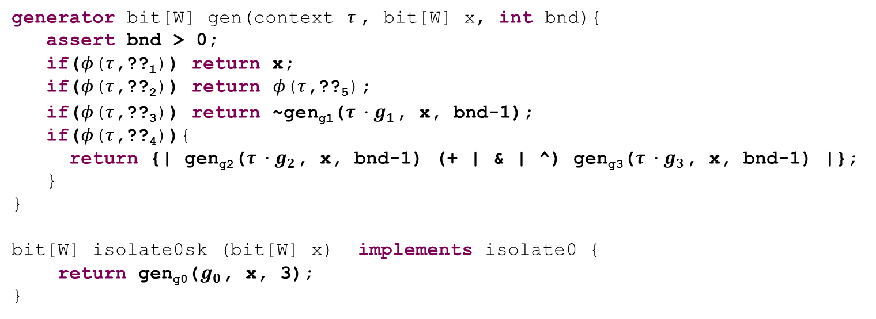


Framing the synthesis problem
generator bit[W] gen(context $τ$, bit[W] x, int bnd){
assert bnd > 0;
if($φ$($τ$,??₁)) return x;
if($φ$($τ$,??₂)) return $φ$($τ$,??₅);
if($φ$($τ$,??₃)) return ~gen_{g1}($τ ⋅g_{1}$, x, bnd-1);
if($φ$($τ$,??₄)){
return {| gen_{g2}($τ ⋅g_{2}$, x, bnd-1) (+ | & | ^) gen_{g3}($τ ⋅g_{3}$, x, bnd-1) |};
}
}
bit[W] isolate0sk (bit[W] x) implements isolate0 {
return gen_{g0}($g_{0}$, x, 3);
}
$φ$($g_{0}$,??_{k})
$φ$($g_{0}g_{1}$,??_{k})
$φ$($g_{0}g_{2}$,??_{k})
$φ$($g_{0}g_{1}g_{2}$,??_{k})
$φ$($g_{0}{g_{1}g}_{3}$,??_{k})
$φ$($g_{0}g_{1}{g_{2}g}_{1}$,??_{k})
...
Potentially unbounded set of unknowns
We can bound the depth of recursion
That means again $φ$ is just a table

Slide 17
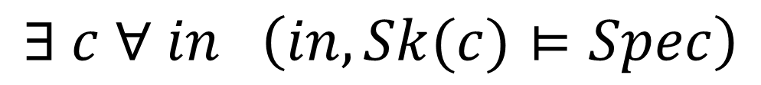
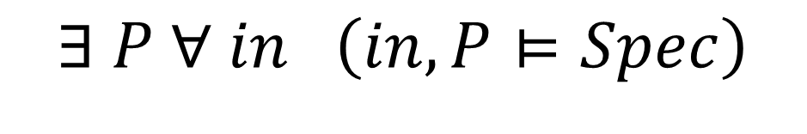
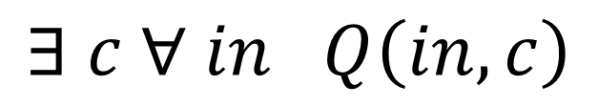
Solving the synthesis problem
$$∃ c ∀ in \left(in, Sk(c)⊨Spec\right)$$
$$∃ P ∀ in \left(in, P⊨Spec\right)$$
$$∃ c ∀ in Q\left(in, c\right)$$
Many ways to represent (𝑖𝑛, 𝑃[𝑐]⊨𝑆𝑝𝑒𝑐)
Important area of research
At the abstract level, it’s just a predicate

Slide 18
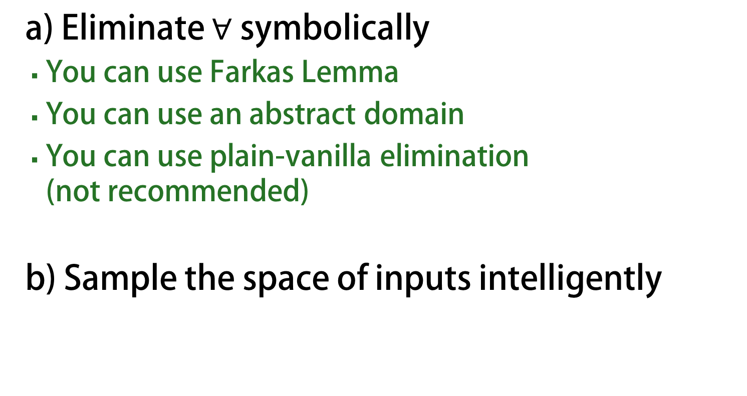
Many different options
a) Eliminate $∀$ symbolically
You can use Farkas Lemma
You can use an abstract domain
You can use plain-vanilla elimination (not recommended)
b) Sample the space of inputs intelligently

Slide 19
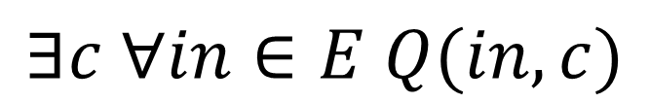
Hypothesis
Sketches are not arbitrary constraint systems
They express the high level structure of a program
A small number of inputs can be enough
focus on corner cases
This is an inductive synthesis problem !
$$∃c ∀in∈E Q(in, c)$$
where E = {x₁, x₂, …, x_{k}}

Slide 20



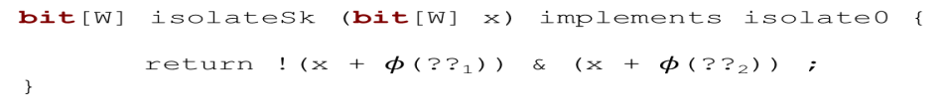
Ex: Sketch
Synthesize
Check
Insert your favorite
checker here
$$∃c s.t. Correct(P_{c}, in_{i})$$
$$∃in s.t. ¬Correct(P_{c}, in_{i})$$
$$in$$
$$\{in_{i}\}$$

Slide 21

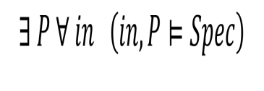








CEGIS in Detail
a
b
c
d
+
$$Q(c, in)$$
+
+
+
+
+
+
+
+
+
+
+
A
A
A
A
Synthesize
Check
$Q_{}(c, in_{0})$
$$c$$
${¬Q}_{}(c, in_{1})$
${¬Q}_{}(c, in_{2})$
${¬Q}_{}(c, in_{3})$
${¬Q}_{}(c, in_{4})$
$Q_{}(c, in_{2})$
$Q_{}(c, in_{3})$
$$in$$
$$\{in_{i}\}$$

Slide 22
applications

Slide 23
Automated Grading
Led by Rishabh Singh with Sumit Gulwani and myself
public class Program {
public static int[] Reverse(int[] a){
int[] b = a;
for (int i=1; i<b.Length/2; i++){
int temp = b[i];
b[i] = b[b.Length-1-i];
b[b.Length-1-i] = temp;
}
return b;
}
}
This should be a zero
public class Program {
public static int[] Puzzle(int[] b) {
int front, back, temp;
int[]a = b;
front = 0;
back = a.Length-1;
temp = a[back];
while (front > back)
{
a[back] = a[front];
a[front] = temp;
++back;
++front;
temp = a[back];
}
return a;
}
}
This should be a <
This should be -- instead of ++

Slide 24
Storyboard Programming
Led by Rishabh Singh
head
next
mid
next
x’ = f
x’= e
x’
a
f
e
b
mid
f
e
x’ = f
e = e’
next
mid
head
x’
f’
e’
next
mid’
next
a
e’
f’
b
Abstract Scenarios
void llReverse(Node head)
{
?? /*1*/
while (?? /*p*/)
{
?? /*2*/
}
?? /*3*/
}
head
head
head
a
next
b
a
head
head
head
a
next
b
a
Concrete Scenarios
Structural Info
Notes:
Explain – we have a text notation not a UI yet.

Slide 25
Storyboard Programming
void llReverse(Node head)
{
Node temp1 = null, temp2 = null,
temp3 = null;
temp1 = head;
while (temp1 != null)
{
// unfold temp1;
head = temp1;
temp1 = temp1.next;
head.next = head;
head.next = temp3;
temp3 = head;
// fold temp3;
}
}
Notes:
It generates the code as well as the unfold and fold annotations that are useful to verify the synthesized implementation.

Slide 26
Relational Ops in Imperative Code
Led by Alvin Cheung with Sam Madden and myself
List getUsersWithRoles () { List users = User.getAllUsers(); List roles = Role.getAllRoles();
List results = new ArrayList();
for (User u : users) {
for (Role r : roles) {
if (u.roleId == r.id)
results.add(u); }}
return results; }
List getUsersWithRoles () { return executeQuery( “SELECT u FROM user u, role r WHERE u.roleId == r.id ORDER BY u.roleId, r.id”; }
convert to
Notes:
How bad is the situation? Here is an example from a real-world aplication
What the dev didn’t know is that the first two method calls actually fetch records from the db, as a result when the outer loop is executed a query will be sent to the db, and likewise for the inner one
To speed things up we could have rewritten this code snippet using a simple SQL query as shown here

Slide 27
Conclusions
Sketch = Generators + synthesis
Constraint based synthesis is a great enabler
You don’t have to start from scratch
Sketch provides a robust and efficient infrastructure for synthesis research

