Slide 1
Language-Parametric Tools
Synthesizing Control-Flow Graph Generators from Operational Semantics
James Koppel
MIT

Slide 2
My Background
Automated migration / mass change
Research intern
Source-to-source
transformation
Program repair
Founder
Other
developer products
Mobile A/B testing
Employee #3
Developer training
Founder

Slide 3
Mission
My Belief
Commercial tools are scarce because it takes a lot of
work to build a tool for a very specific problem
My Goal
Make tools more general and easier to build
By
sharing code across
the same tool
for different languages
sharing code across
different tools
for the same language
by generating tools
from language semantics
Cubix
(OOPSLA ‘18)
Mandate
(in submission)
(future)

Slide 4
Different Places
Cubix Framework
Mandate
“Third-generation” project
Works on C, Java, JS, Lua, Python
Loves language corner-cases
Hardcore generic programming
Being used to create “real” tools
Spherical cows, not in a vacuum
Works on Tiger, MITScript
These languages have no corner cases
Semantics engineering, term-rewriting
Some slides are things I got working last week

Slide 5
Cubix Framework
(OOPSLA ‘18)

Slide 6
Multi-Language Transformation
Language 1
Transform
Share work
Transform
Language 2

Slide 7
I know! I’ll use an IR.

Slide 8
Designing an IR
Least-common
denominator
Loses information

Slide 9
Oops
int sum(int n)
{
int tot = 0;
for (int i = 0; i < f(n); i++)
{
tot += globArr[i];
}
return tot;
}
Sketch
void sum (int n, ref int _out,
ref global int[3] globArr_s8) {
_out = 0; _out = 0;
int _out_s5 = 0; f(n, _out_s5);
bit __sa0 = 0 < _out_s5; int i = 0;
while(__sa0) {
_out = _out + (globArr_s8[i]);
i = i + 1;
int __sa0_s7 = 0;
f(n, __sa0_s7);
__sa0 = i < __sa0_s7;
}
return;
}
for
while

Slide 10
Designing an IR
Union of languages

Slide 11
Language-agnostic?
Language-parametric

Slide 12
Sharing Work
Fragment 1
Transform
Fragment 2
Transform
Fragment 3
Transform

Slide 13
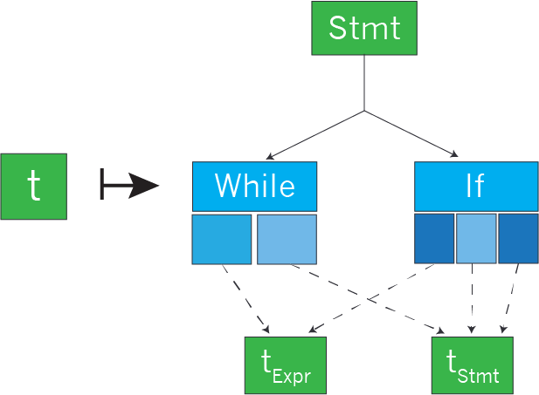
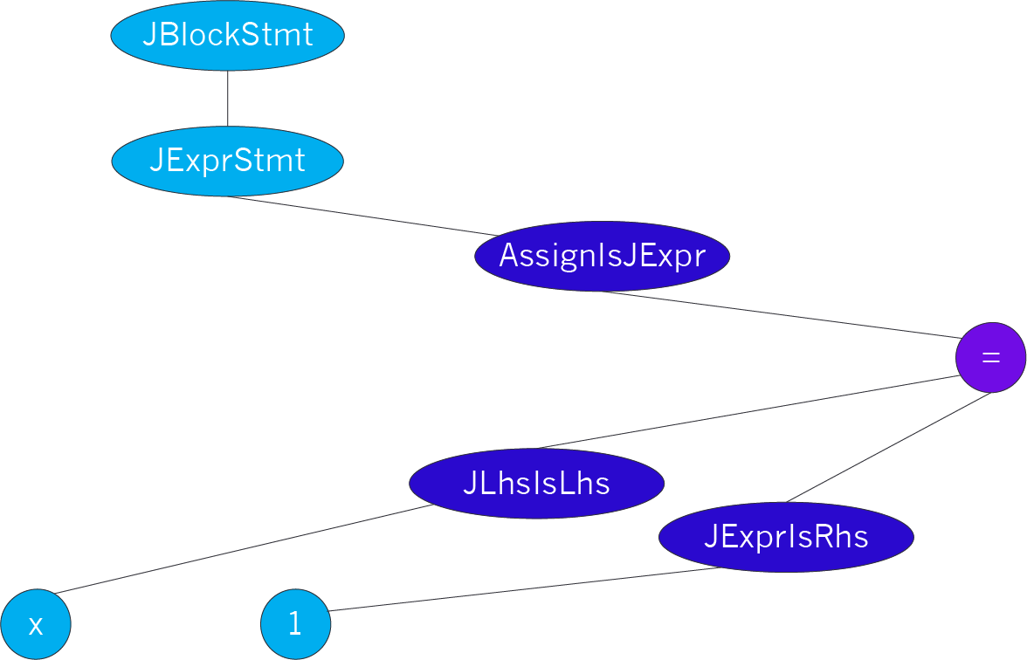
Incremental Parametric Syntax

Slide 14
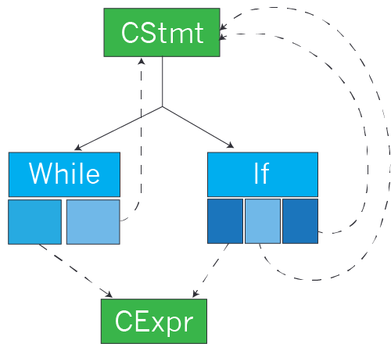
Syntax Definitions
data CStmt =
While CExpr CStmt
| If CExpr CStmt CStmt
Notes:
Show both CStmt and JStmt. Want to write a function which swaps branches.

Slide 15
What Hinders Modularity?
Notes:
Show both CStmt and JStmt. Want to write a function which swaps branches.

Slide 16
Can we work with language fragments instead?

Slide 17
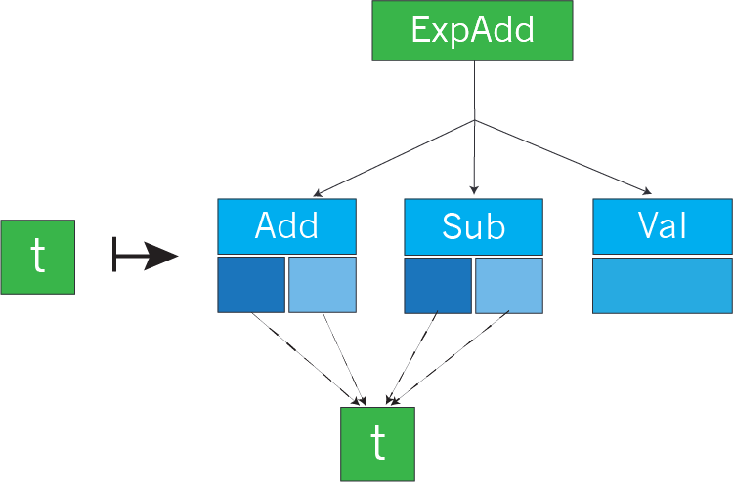
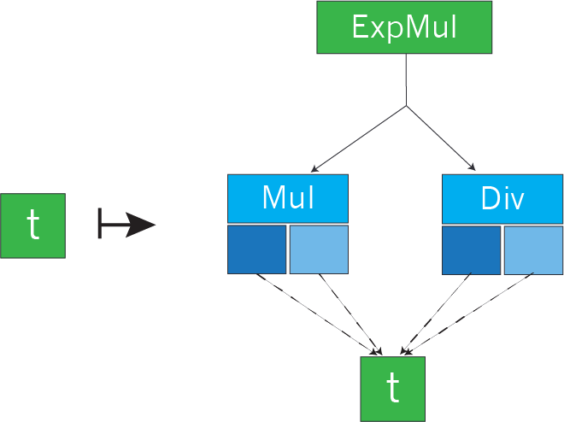
Datatypes á la Carte
(W. Swierstra, 2008)
data ExpAdd t where
Add :: t → t → ExpAdd t
Sub :: t → t → ExpAdd t
Val :: Int → ExpAdd t
data ExpMul t where
Mul :: t → t → ExpMul t
Div :: t → t → ExpMul t
Notes:
First show it with two type parameters, then say “we actually do this a bit more fancilly”
Point is: This can now be Stmt, not CStmt
Must explain issue of recursion and sorts separately

Slide 18
Designing an IR
???
Notes:
Plans:
Where we are now:
Have modular representations, still no shared parts
Want: Shared components
E.g.: shared assignment node
Problems:
Different context:
C/Java: Assign is expression. Lua: assign is statement
Different subnodes: C LHS vs. Lua exp
Thought bubble: “I want to be able to insert

Slide 19

Goal
Notes:
Plans:
Where we are now:
Have modular representations, still no shared parts
Want: Shared components
E.g.: shared assignment node
Problems:
Different context:
C/Java: Assign is expression. Lua: assign is statement
Different subnodes: C LHS vs. Lua exp
Thought bubble: “I want to be able to insert

Slide 20
A Generic VarDecl

Slide 21
Customizing a Generic VarDecl
Sort injection:
JavaType is VarDeclAttrs

Slide 22
Big Idea: Sort Injections
Sort injection:
JavaType is VarDeclAttrs

Slide 23
Mixed Trees
Notes:
Show starting with a specific tree, want to replace assignment with generic, show process
For terms: make “x=y”, not “Term_CExpr”
Show this diagram again, without those nodes, and then show them being added back in
Also need a slide to show multiple languages and to show how the same generic component can be treated differently

Slide 24
Cubix: Results
Built support for 5 languages
Built three semantics-preserving transformations, each for 3-5 languages.
Pass 100% of compiler tests
Turing Test: Output no less readable than hand-transformed code
Prototyped a realistic whole-program transformation (“interprocedural plumbing transformation”) for 5 languages in 40 hours total. Good enough
Biggest use: Changed 484 lines across 41 files

Slide 25
Testing Transformations: The RWUS Suite
function stat_resource(resource)
if type(resource) == 'string' then
return FS.statSync(resource)
else
FS.fsyncSync(resource)
return FS.fstatSync(resource)
end
end
50 code samples from top Github projects
7000 lines of tests
for 1000 lines of code
Call order
checked
Arguments checked

Slide 26
Mandate: A CFG-Generator Generator
genCfg (Assn x e) = do
(start, end) <- makeNodes
(eStart, eEnd) <- genCfg e
connect start eStar
connect end eEnd
return (start, end)
genCfg (Assn x e) = do
(start, end) <- makeNodes
(eStart, eEnd) <- genCfg e
connect start eStar
connect end eEnd
return (start, end)
Notes:
Next slides:
Motivation
Goal is to derive tools (symbol table, analyzer, compiler, …)
Why is this a prereq for deriving static analysis?
How the F do you get a CFG from this stuff?
CFG examples
Here’s a basic block CFG
Here’s a statement-level CFg
…but the recursion sucks
Here’s an expression-level CFG (and the recursion is nice)
Path-sensitive?
Slide showing: Hmm…abstract machine seems the right approach
Slide showing: Oops, we need our own SOS-to-CFG algorithm (also, Danvy just did lambda calculus)
Slide showing grammar of terms and SOS rules
1 slide about PAM
1 slide about not doing AAM
1 slide: “But hmm, we’re syntactic”
Abstract rewriting slides

Slide 27
Vision
My new language needs a
Symbol table generator
Control-flow graph generator
Compiler
Symbol execution engine
Model checker
Dataflow analysis library

Slide 28
Vision
Semantics
Symbol table generator
Symbol execution
Compiler
Mandate
Model checker
Control-flow graph generator

Slide 29
What does a CFG look like?
b = prec < 5;
if (b) {
print("(");
}
print(left);
print("+");
print(right);
if (b) {
print(")");
}
Option 1: Basic Block
Option 2: Statement-Level
More Options Coming
Notes:
Say upfront: We’ll give you lots of options, and they’re all right, and we can generate all of them.

Slide 30
What does a CFG generator look like?
genCfg (If e s1 s2) after = do
node <- newNode
s1Node <- genCfg s1 after
s2Node <- genCfg s2 after
connect node s1Node
connect node s2Node
return node
Option 2: Statement-Level
More Options Coming

Slide 31
What does a CFG generator look like?
genCfg (If e s1 s2) = do
enter <- newNode
exit <- newNode
(s1In, s1Out) <- genCfg s1
(s2In, s2Out) <- genCfg s2
connect enter s1In
connect enter s2In
connect s1Out exit
connect s2Out exit
return (enter, exit)
Option 3:
Statement-Level
Two-nodes per
Option 4:
Expression-Level
More Options Coming

Slide 32
What does a CFG look like?
Option 1: Basic Block
Option 3: Expression-Level
Option 4:
Flow-sensitive
Splitting on “b”
Statement-level
Option 2: Statement-Level
Notes:
Beware: Yannis saw the expression-level CFG and thought it was a dataflow-dependence graph
Green edge is hard to see.

Slide 33
We need all all CFGs
Analyzer 1
needs
Expression-Level
Analyzer (1 join 2)
needs
Flow-sensitive,
expression-level
!
Analyzer 2
needs
Flow-sensitive,
statement-level

Slide 34
What is a CFG, anyway?
???
What are the nodes?
Subterms?
Continuations?

Slide 35
Abstract Machine States

Slide 36
Inter-deriving Semantics
Denotational Semantics
Reynolds ‘72
Structural-Operational Semantics
Us
Big-Step Semantics
Us
Danvy ‘08
(example, not algorithm)
Phased Abstract Machine
(PAM)
Hannan & Miller, ’92
Ager, Danvy, et al ’03-’04
Us
Reduction Semantics
Small-Step
Abstract Machines
Big-step
Abstract Machines
Danvy et al, ‘04
Danvy et al, ‘04

Slide 37
Inter-deriving Semantics
Denotational Semantics
Older work:
λ-calculus
Structural-Operational Semantics
Big-Step Semantics
Us
PAM
Us:
Tiger
MITScript
Reduction Semantics
Small-Step
Abstract Machines
Big-step
Abstract Machines

Slide 38
Plan

Slide 39
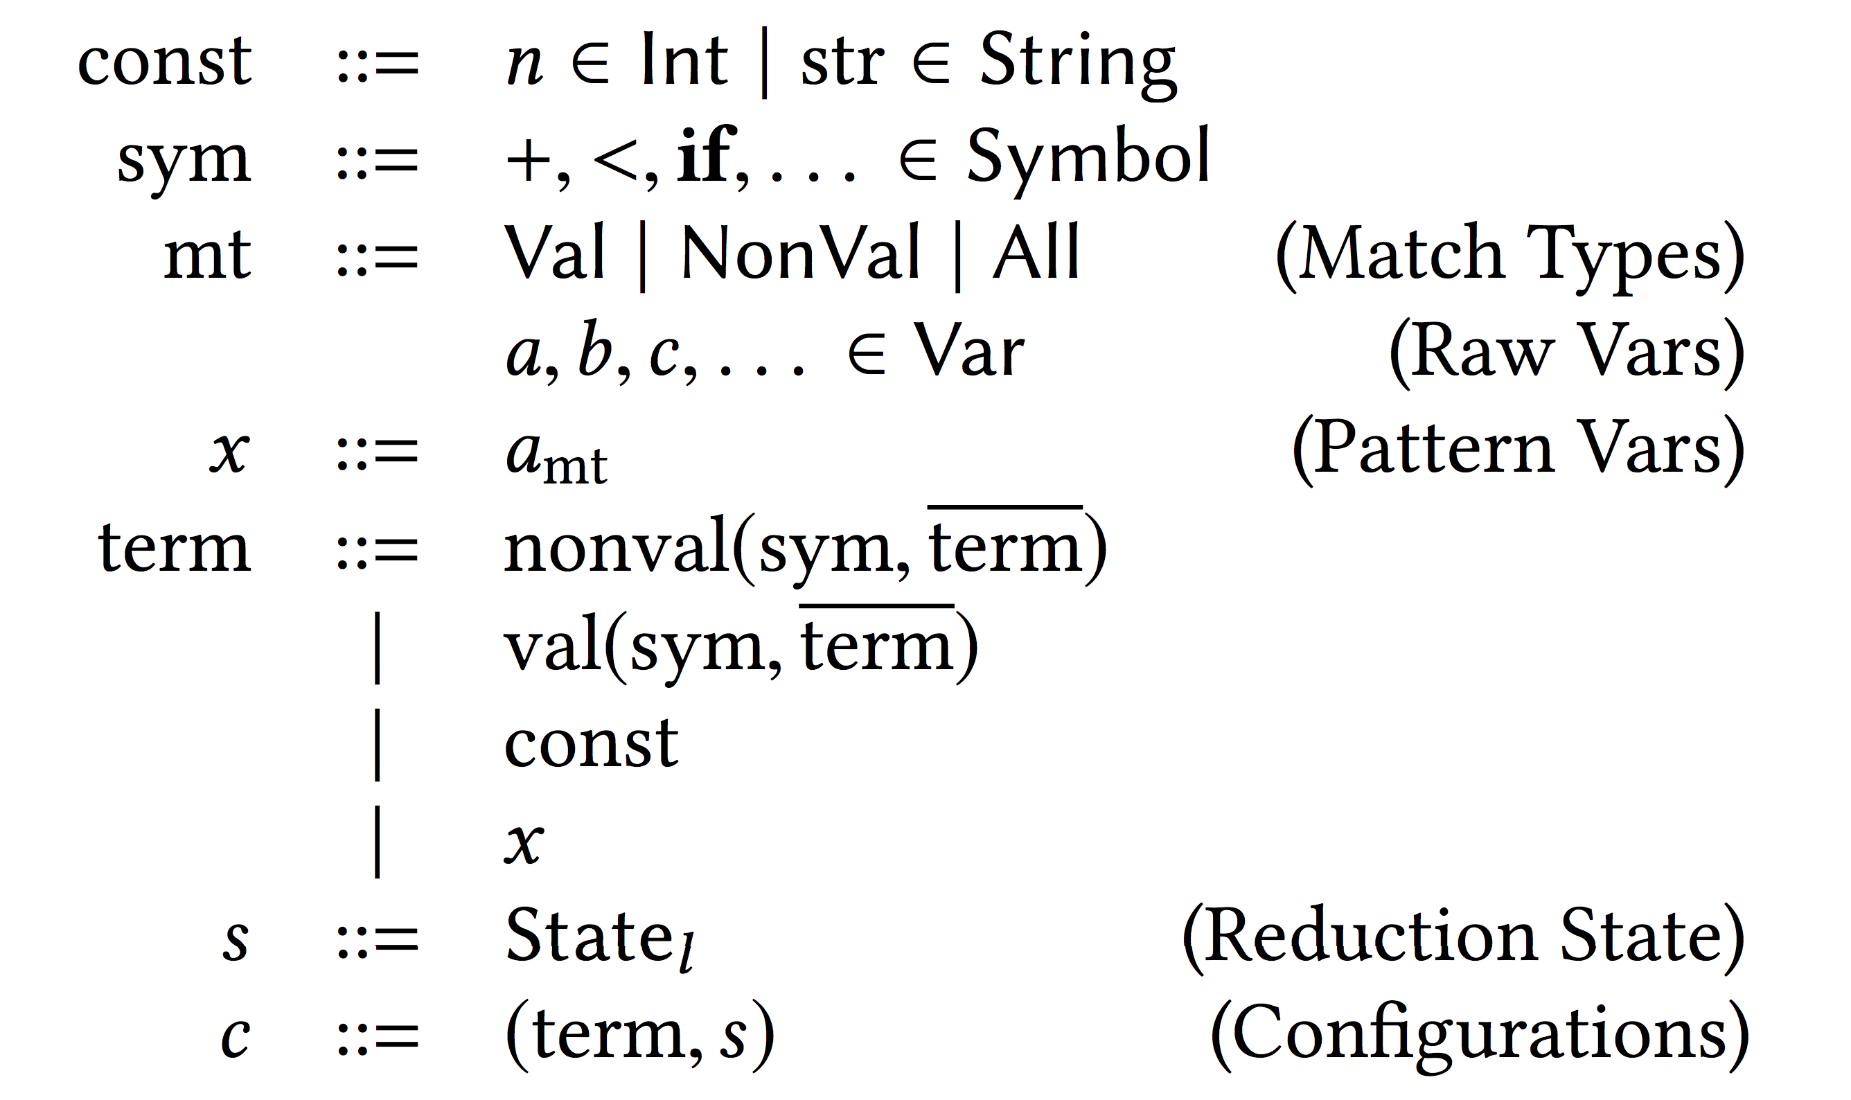
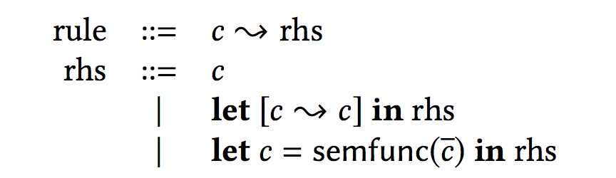
Meta-metalanguage
Terms / Patterns
SOS: “Straightened Operational Semantics”

Slide 40
SOS/AM Correspondence

Slide 41
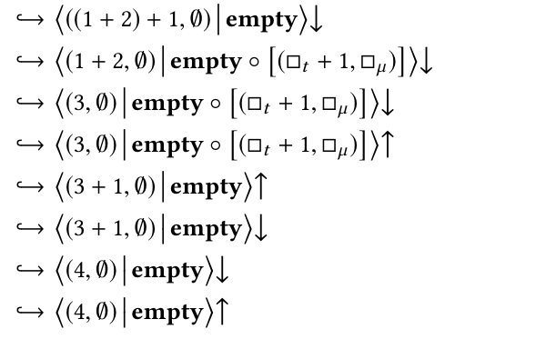
PAM: The Phased Abstract Machine

Slide 42
Abstract Rewriting
Abstract states = CFG nodes
α
★
Notes:
THIS SLIDE IS TOTALLY WRONG.
The transitions aren’t right.

Slide 43
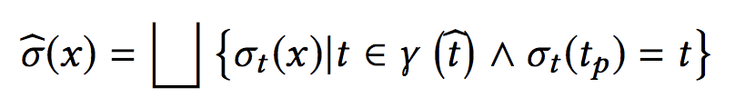
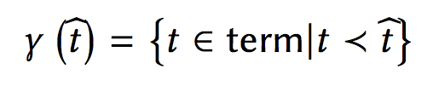
Abstract Rewriting
Abstraction Ordering
Abstract Matching
≺ is the reflexive, transitive, congruent closure of:
★
Example
λx_{Val}. e_{NonVal} matches ★_{All} with
= [x ↦ ★_{Val} , y ↦ ★_{NonVall} ]
Representation

Slide 44
Abstractions
Four components:
Abstract term
Abstract state
Abstract continuation
Abstract semantic functions
Usually: Just make them return ★_{Val}
Sometimes: abs(<)(x,y) = {True, False}
★

Slide 45
Abstractions
Abstraction
Examples
Yields
(1+1, []) -> (★_{Val} + ★_{Val} , [])
★
Value-irrelevance: Values to ★_{Val}
Expression-level CFG
(x, [x->1]) -> (x, [x-> ★_{Val}])
Expression-irrelevance: Expressions to ★_{Val}
(and over-approximate state-changes)
(1+1, []) -> (★_{Val}, [])
Statement-level CFG
(★_{NonVal}, []) -> (★_{Val}, [★_{Val ->} ★_{Val}])
Boolean-tracking for b:
In program: Non-boolean values to ★_{Val}
In state: Everything to ★_{Val}, exception value of b
(true, [b->false, c->true]) ->
(true, [b -> false, c -> ★_{Val} ])
Flow-sensitive CFG
Expression-level

Slide 46
Projections
★

Slide 47
Which CFG?
Choice of CFG determined by
choice of abstraction/projection (α, π)
Option 1: Basic Block
Option 2: Statement-Level
we can generate
any of these
Option 3: Expression-Level
Option 4:
Flow-sensitive
Splitting on “b”
Statement-level

Slide 48
Plan

Slide 49
Graph Patterns

Slide 50
Graph Patterns
genCfg (Add a b) = do
(start, end) <- makeNodes
(aStart, aEnd) <- genCfg a
(bStart, bEnd) <- genCfg b
connect start aStar
connect aEnd bStar
connect eEnd end
return (start, end)

Slide 51

Thanks to my students!
Undergrad
Angel Huang
Diana Molodan
Arman Talkar
Elijah Rivera
Master’s
Former Students
Pond Premtoon
Jackson Kearl
Jasper Haag

