Slide 1
A Lightweight Approach to Module Generation
Takahisa Watanbe
Yukiyoshi Kameyama
University of Tsukuba, Japan
Notes:
プレゼンテーション作成全体に関するメモ:
[ソースコードの色付け]
http://pygments.org/
theme: Friendly
ソースコードを上記ウェブサービス (コマンドライン版もある)に貼り付け, 色付け結果をコピペして
PowerPointにRTF形式ではりつける

Slide 2
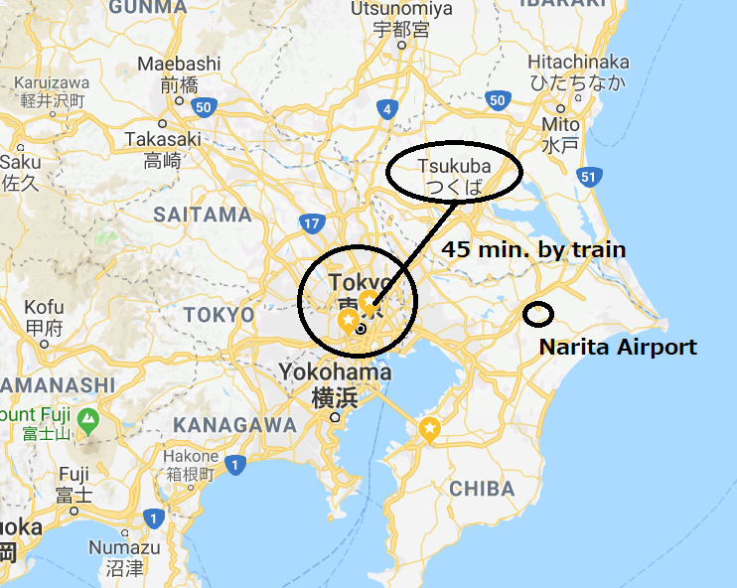

Slide 3








Type-safe Program Generation
Base System Type System
+ Program Generation
$$e∷=x∣λx.e∣e e$$
$$τ∷=b∣τ→τ$$
$$Γ ⊢e :τ$$
$$e∷=…$$
$∣ \left\langle e\right\rangle code$
$| \sim e splice$
$| ! e$ run
$| \% e csp$
$$\frac{\begin{aligned}λ□ \\ Δ ; ⋅ ⊢ e :τ \end{aligned}}{Δ ; ⋅ ⊢\left\langle e\right\rangle :□τ }$$
MetaOCaml
$$λα, λi$$
$$\frac{\begin{aligned}λ〇 \\ Γ⊢^{i+1}e :τ \end{aligned}}{Γ⊢^{i}\left\langle e\right\rangle :〇τ }$$
$$▶$$
$$λ$$
Tsukada&Igarashi
BER MetaOCaml

Slide 4
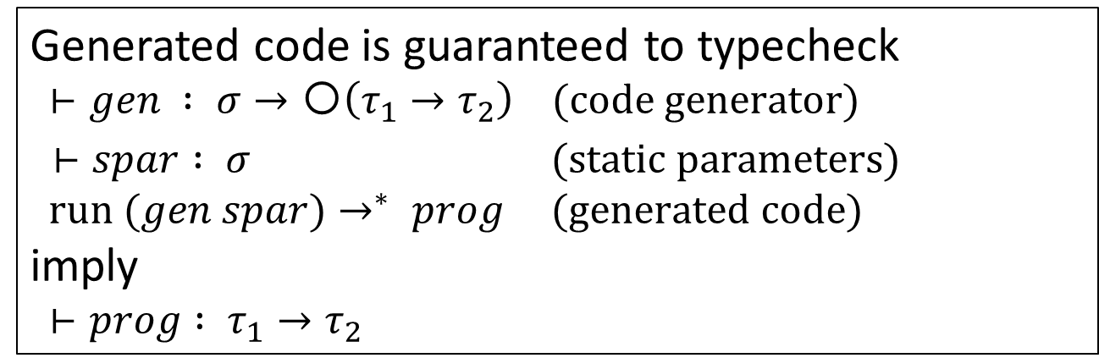
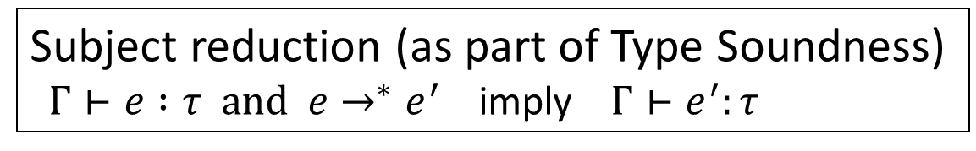
Type-safe Program Generation
Fundamental Theorem to be proved
Implication
Subject reduction (as part of Type Soundness)
$Γ⊢e :τ and e→^{∗}e^{′}$ imply $Γ⊢e^{′}:τ$
Generated code is guaranteed to typecheck
$⊢gen : σ→〇\left(τ_{1}→τ_{2}\right) (code generator)$
$⊢spar : σ$ (static parameters)
$run (gen spar)→^{∗} prog (generated code)$
imply
$⊢prog : τ_{1}→τ_{2}$

Slide 5
Type-Safe Program Generation
Question.
Can we generate only terms (expressions)?
“Staging Beyond Terms”, Jun Inoue et al., PEPM 2015
Generating declarations, e.g.,
mutually recursive functions
patterns, pattern cases
types, modules, type classes
pragmas, “#include”

Slide 6
Example 1

Slide 7
Robin’s case: an intern student who has little experience in functional programming
He wrote a code generator for matrix multiplication
He soon realized that the elements of arrays should be float.
let matmul (n : int) :
(int array -> int array -> int array -> unit) code =
。。。。。。
c.(i * n + j) <- c.(i * n + j) +
a.(i * n + k) * b.(k * n + j)
。。。。。。
let matmul (n : int) :
(float array -> float array -> float array -> unit) code =
。。。。。。
c.(i * n + j) <- c.(i * n + j) +.
a.(i * n + k) *. b.(k * n + j)
。。。。。。

Slide 8
Robin’s case (continued)
But then he wanted to write matmul for complex numbers.
Finally, he may want to abstract the program by modules and functors.
let matmul (n : int) :
(Complex.t array -> Complex.t array -> Comlex.t array -> unit) code = ….
c.(i * n + j) <- Complex.add c.(i * n + j)
(Complex.mul a.(i * n + k)
b.(k * n + j)) ….
module Matmul (Elem : RING) = struct
let matmul n = .<fun a b c -> …
c.(i * n + j) <- Elem.add c.(i * n + j)
(Elem.mul a.(i * n + k)
b.(k * n + j))
…>.
end

Slide 9
Robin’s case (continued)
He is happy – his matmul module can take an arbitray RING structure as the element type.
Unfortunately the generated code suffers from performance problem.
module Mmint = Matmul (IntRing)
module Mmfloat = Matmul (FloatRing)
module Mmcomplex = Matmul (ComplexRing)
module Matmul (Elem : RING) = struct
let matmul n = .<fun a b c -> …
c.(i * n + j) <- Elem.add c.(i * n + j)
(Elem.mul a.(i * n + k)
b.(k * n + j))
…>.
end
Indirect access, not resolved at complie time

Slide 10
Example 2

Slide 11
Module abstraction in ML (1/3)
module type SET = sig (* type of module *)
type elt_t (* abstract type *)
type set_t (* abstract type *)
val member : elt_t -> set_t -> bool
end
module IntSet = struct (* concrete module *)
type elt_t = int
type set_t = int list
let rec member elt set =
match set with
| [] -> false
| hd::tl -> (elt = hd) || (member elt tl)
end
: SET

Slide 12
Module abstraction in ML (2/3)
module type SET = sig
type elt_t
type set_t
val member : elt_t -> set_t -> bool
end
module RecordSet : SET = struct (* another impl. *)
type elt_t = {id : int; name : string}
type set_t = {id : int; name : string} list
let rec member elt set =
match set with
| [] -> false
| hd::tl -> (elt.id = hd.id) || (member elt tl)
end
We may also implement the set using arrays, Hash tables etc.

Slide 13
Module Abstraction in ML (3/3)
Abstracting element types by Functors
MakeSet: EQTYPE -> SET
module MakeSet (EqType : EQTYPE) : SET = struct
type elt_t = EqType.t
type set_t = EqType.t list
let rec member elt set =
…
… (EqType.eq elt hd) || …
end
module type EQTYPE = sig
type t
val eq : t -> t -> bool
end
module IntEq = struct
type t = int
let eq = (=) (* equality function for int *)
end
module IntSet = MakeSet (IntEq)
Notes:
IntSetとMeiboには重複している部分も多い.
そういう場合は, 共通部分をくくりだすことによる抽象化を考えたくなる.

Slide 14
Abstraction overhead
module MakeSet (EqType : EQTYPE) = struct
type elt_t = EqType.t
type set_t = EqType.t list
let rec member elt set =
match set with
| [] -> false
| hd :: tl -> (EqType.eq elt hd) || (member elt tl)
end
Indirect access to the equality function
Notes:
下から説明する

Slide 15
Example 3

Slide 16
Embedded DSL by Tagless-final Embedding
SQL as an embedded DSL [Suzuki+ 2015]
Optimization as a functor (a function over modules)
Iterated optimizations via recursive functors
We should be able to inline the optimizations, but functors do not allow it.
module rec Fix : (SymanticsL with…) = struct
module Tfix = ForFor(ForWhere(ForYield(Fix))
module T = GenSQL
type α repr = {again : unit -> α Tfix.repr; …}
let if_ b x y = {again = fun () -> Tfix.if_ (b.again())
(fun () -> (x ()).again ()) …}
…
end
Notes:
下から説明する

Slide 17
Abstraction Overhead
- more abstractions, poorer performance
Abstraction
IntrRing
FloatRing
MMInt
MMfloat
MatMul
Concretization
Modularity, Reusability, Maintainability
Performance
Staging should be a clue.
“Abstraction without Guilt / Regret”
Notes:
MLモジュールとファンクターについて整理した図
抽象化と実行効率が対立するという構図は, まさにコード生成法が有用な例である.

Slide 18
Problem to be addressed

Slide 19
Eliminating function abstraction and application
let rec iterate f n x =
if n = 0 then x
else iterate f (n-1) (f x) ;;
iterate (fun y -> y * 2) 5 x ;;
iterate (fun y -> < ~y * 2 >) 5 <3> ;;
<3 * 2 * 2 * 2 * 2 * 2>
let eta f = <fun x -> ~( f <x> )> in
eta (iterate (fun y -> < ~y * 2>) 5) ;;
<fun x -> x * 2 * 2 * 2 * 2 * 2>
⟶
<e> quasi-quotation
~e anti-quotation
⟶
Notes:
x^nを計算する関数. 再帰呼び出しのオーバーヘッド
赤字のマルチステージ構成子をつけることで, コード生成器になる.
N が 具体的に分かっている場合は, この再帰呼び出しを展開して,
この実行時オーバーヘッドを削減できる.
N=5の場合が power5
power5を実行して得られた関数に2を適用すると2^5が計算されて、32になる

Slide 20
Eliminating functor abstraction and application
module MakeSet (EqType : EQTYPE) = struct
type elt_t = EqType.t
type set_t = EqType.t list
let rec member elt set =
match set with
| [] -> false
| hd :: tl -> (EqType.eq elt hd) || (member elt tl)
end
We need to consider
types in module code,
and decompose
a module code.
let makeSet (EqType : EQTYPE code) : SET code =
< struct
type elt_t = EqType.t
type set_t = EqType.t list
let rec member elt set =
match set with
| [] -> false
| hd :: tl -> (~(EqType.eq) elt hd)
|| (member elt tl)
end >

Slide 21
Guided by Types

Slide 22
“Isomorphism” around code types
Code type is a modal type (Davies&Pfenning, Davies, Taha&Nielsen)
Code type commutes with conjunction and implication [Taha]
< 1 + 2 > : int code
< 1 + 2 > : 〇 int
fun (x,y) -> <(~x, ~y)>
: (α code * β code) -> (α * β) code
… : (〇α⋀〇β) ⇒〇(α⋀β)
fun p -> (<fst ~p>, <snd ~p>)
: (α*β) code -> α code * β code
… : 〇(α⋀β) ⇒ (〇α⋀〇β)
fun f -> <fun x -> ~(f <x>)>
: (α code -> β code) -> (α->β) code
… : (〇α->〇β)⇒〇(α->β)
fun f -> fun x -> <~f ~x>
: (α->β) code -> α code -> β code
… : 〇(α->β)⇒ (〇α->〇β)

Slide 23
“Isomorphism” around code types
Code type does NOT commute with disjunction, though
fun x -> match x with
| Left(y) -> < Left(~y) >
| Right(z) -> <Right(~z)>
: (α code + β code) -> (α + β) code
… : (〇α∨〇β) ⇒〇(α∨β)
NO TERM
: (α*β) code -> α code * β code
… : 〇(α∨β) ⇒ (〇α∨〇β)
Reason:
Disjunction is informative.
We should not be able to know the information in future.

Slide 24

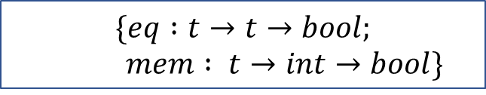
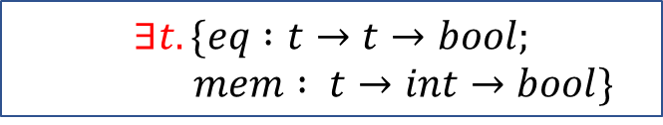
Isomorphism for module types
The type of a module (without abstract types) roughly corresponds to a record type.
An abstract type corresponds to an existential type. [Mitchell & Plotkin]
A functor is a function over modules.
sig
val eq : t -> t -> bool
val mem : t -> int -> bool
end
$$\{eq :t→t→bool;$$
$mem : t→int→bool\}$
sig
type t
val eq : t -> t -> bool
val mem : t -> int-> bool
end
$$∃t.\{eq :t→t→bool;$$
$mem : t→int→bool\}$
let makeSet (…) = …
makeSet : $(∃X. A)→(∃Y.B)$

Slide 25
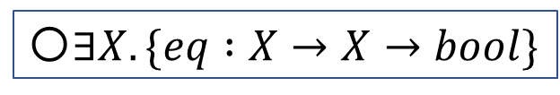
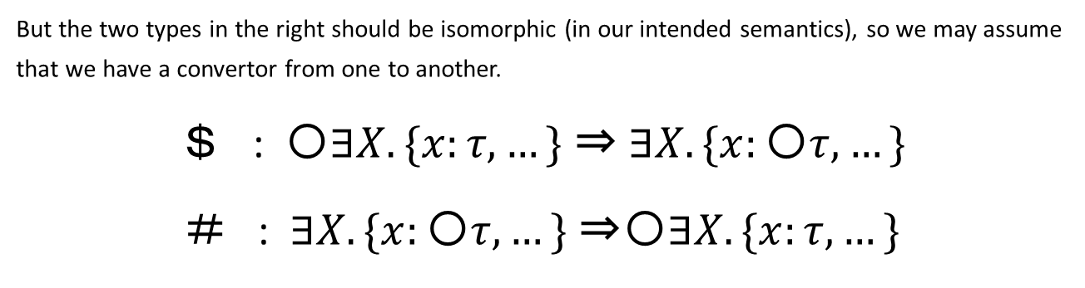

Isomorphism for module types
e : (sig
type t
val eq : t -> t -> bool
end) code
〇$∃X. \{eq :X→X→bool\}$
?? : (sig
type t
val eq : (t->t->bool) code
end)
$$∃X. \{eq :〇(X→X→bool)\}$$
But the two types in the right should be isomorphic (in our intended semantics), so we may assume that we have a convertor from one to another.
＄ : 〇$∃X. \{x:τ, …\}$ ⇒ $∃X. \{x:〇τ, …\}$
＃ : $∃X. \{x:〇τ, …\}$ ⇒〇$∃X. \{x:τ, …\}$

Slide 26
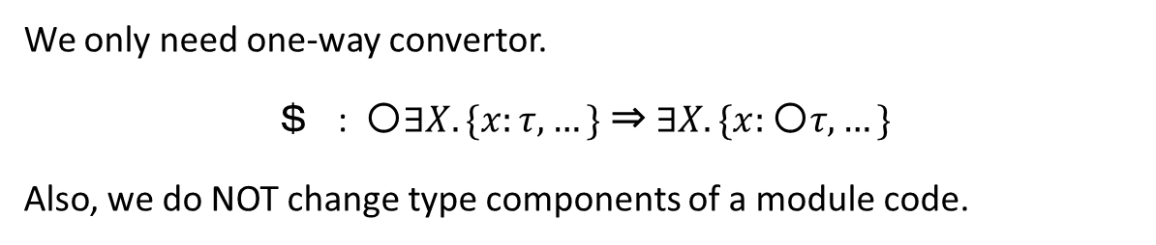
Isomorphism for module types
e : (sig
type t
val eq : t -> t -> bool
end) code
〇$∃X. \{eq :X→X→bool\}$
$e : (sig
type t
val eq : (t->t->bool) code
end)
$$∃X. \{eq :〇(X→X→bool)\}$$
We only need one-way convertor.
＄ : 〇$∃X. \{x:τ, …\}$ ⇒ $∃X. \{x:〇τ, …\}$
Also, we do NOT change type components of a module code.

Slide 27
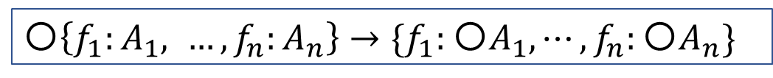
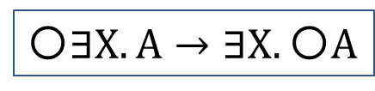
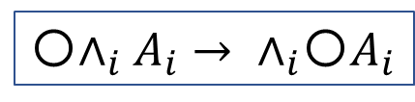
What types correspond?
$ is composed by the following two.
Code-Existential exchange
Code-record exchange
〇$∃X. A→∃X.〇A$
〇$\left\{f_{1}:A_{1}, …, f_{n}:A_{n}\right\}→\{f_{1}:〇A_{1},⋯,f_{n}:{〇A}_{n}\}$
Record is a generalized product.
〇$∧_{i}A_{i}→{ ∧}_{i}〇A_{i}$

Slide 28
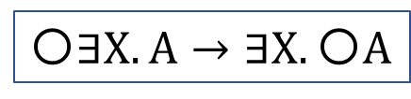

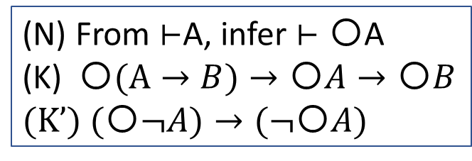

What types correspond?
The logic of our system (approximately) consists of
Axioms and inference rules in ordinary logic and $λ$〇
2. Exchange
TODO: Study the meta-theoretic properties of this type system.
From $⊢$A, infer $⊢〇$A
(K) 〇$(A→B)→〇A→〇B$
(K’) $(〇¬A)→(¬〇A)$
〇$∃X. A→∃X.〇A$
〇$∧_{i}A_{i}→{ ∧}_{i}〇A_{i}$

Slide 29
Our Solution

Slide 30
module MakeSet (EqType : EQTYPE) = struct
type elt_t = EqType.t
type set_t = EqType.t list
let rec member elt set =
match set with
| [] -> false
| hd :: tl -> (EqType.eq elt hd) || (member elt tl)
end
Eliminating functor
abstraction and application
let makeSet (EqType : (module EQTYPE) code) =
< (module struct
type elt_t = %( EqType.t)
type set_t = %( EqType.t) list
let rec member elt set =
match set with
| [] -> false
| hd :: tl -> (~( EqType.eq) elt hd)
|| (member elt tl)
end : SET) >
$
$
First-class module
Program Generation
This work’s extension
$
module IntSet = run_module (val (makeSet <IntEq>))

Slide 31
Eliminating functor abstraction and application
let makeSet (EqType : (module EQTYPE) code) =
< …
type elt_t = %( EqType.t)
type set_t = %( EqType.t) list
… (~( EqType.eq) elt hd) …
>
3. This work’s extension
$
$
$
We want to extract the components t and eq from EqType which is
code of a module.
Example of EqType:
<struct
type t = int
let eq = (=)
end>
Notes:
本研究ではMetaOCamlのようにコード構成子を付加するだけで,
モジュールコードの生成が行えるマルチステージ言語を設計した.
このプログラムは本研で提案するマルチステージ言語を用いて
makeSetの例をモジュール生成器にしたものである.
以下, このようなマルチステージ言語の設計と, ソースコード中の青字で示した
本研究で導入したマルチステージ構成子について説明する.

Slide 32
Eliminating functor abstraction and application
let makeSet (EqType : (module EQTYPE) code) =
< …
type elt_t = %( EqType.t)
type set_t = %( EqType.t) list
… (~( EqType.eq) elt hd) …
>
3. This work’s extension
$
$
$
The operator $ converts code of a module to a module of code.
EqType : (module EQTYPE) code
where
EQTYPE = sig
type t
val eq : t -> t -> bool
end
$EqType : module EQTYPE_c
where
EQTYPE_c = sig
type t (*NO code of type*)
val eq : (t -> t -> bool) code
end
Notes:
本研究ではMetaOCamlのようにコード構成子を付加するだけで,
モジュールコードの生成が行えるマルチステージ言語を設計した.
このプログラムは本研で提案するマルチステージ言語を用いて
makeSetの例をモジュール生成器にしたものである.
以下, このようなマルチステージ言語の設計と, ソースコード中の青字で示した
本研究で導入したマルチステージ構成子について説明する.

Slide 33
Eliminating functor abstraction and application
let makeSet (EqType : (module EQTYPE) code) =
< …
type elt_t = %( EqType.t)
type set_t = %( EqType.t) list
… (~( EqType.eq) elt hd) …
>
3. This work’s extension
$
$
$
We need to embed the type EqType.t into code of a module. (Similar to cross-stage persistence, but at the type level.)
Notes:
本研究ではMetaOCamlのようにコード構成子を付加するだけで,
モジュールコードの生成が行えるマルチステージ言語を設計した.
このプログラムは本研で提案するマルチステージ言語を用いて
makeSetの例をモジュール生成器にしたものである.
以下, このようなマルチステージ言語の設計と, ソースコード中の青字で示した
本研究で導入したマルチステージ構成子について説明する.

Slide 34
Eliminating functor abstraction and application
let makeSet (EqType : (module EQTYPE) code) =
< (module struct
type elt_t = %( EqType.t)
type set_t = %( EqType.t) list
let rec member elt set =
match set with
| [] -> false
| hd :: tl -> (~( EqType.eq) elt hd)
|| (member elt tl)
end : SET) >
$
First-class module
Program Generation
This work’s extension
$
$
module IntSet = run_module (val (makeSet <IntEq>))
Notes:
本研究ではMetaOCamlのようにコード構成子を付加するだけで,
モジュールコードの生成が行えるマルチステージ言語を設計した.
このプログラムは本研で提案するマルチステージ言語を用いて
makeSetの例をモジュール生成器にしたものである.
以下, このようなマルチステージ言語の設計と, ソースコード中の青字で示した
本研究で導入したマルチステージ構成子について説明する.

Slide 35
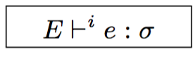
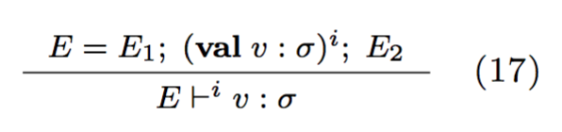
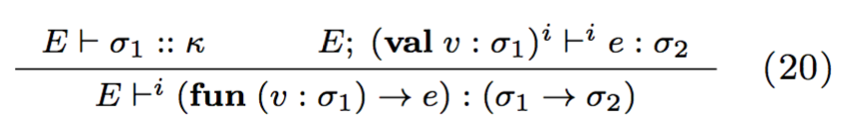
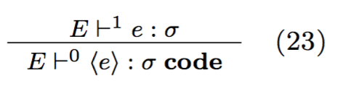
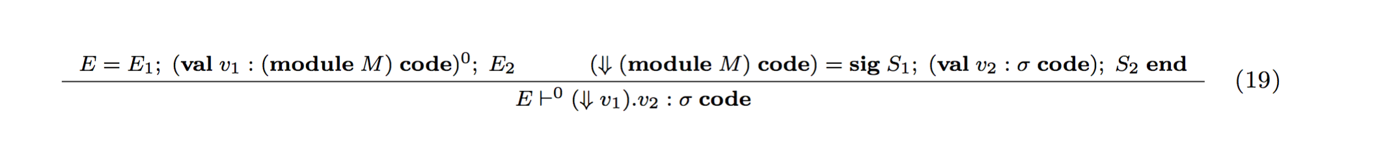
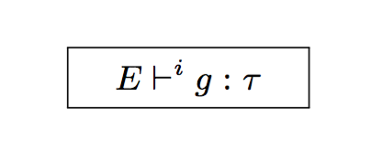
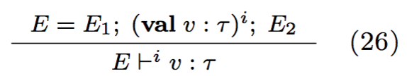
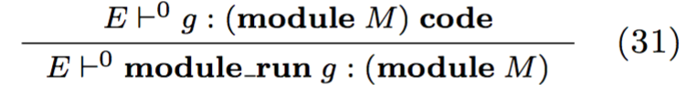
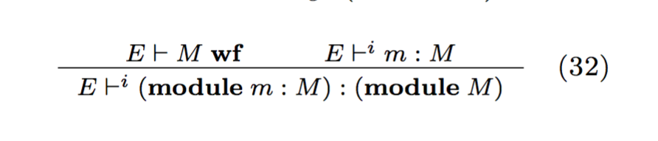
Type system for λ^{<M>}
Core ML + 1st classs module + code generation + this work
  Module system based on “Modular module system” [Leroy, 2000]

Slide 36

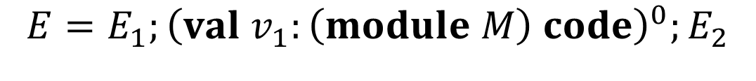

Type system for λ^{<M>}
Core ML + 1st classs module + code generation + this work
$$E=E_{1};{\left(val v_{1}:\left(module M\right) code\right)}^{0};E_{2}$$
$$M=sig { S}_{1};{…; S}_{n} end$$
$$E⊢^{0}\left(⇓v_{1}\right) :(sig {⇓S}_{1};…;{⇓S}_{n}end)$$
$$⇓(type t=σ)≔\left(type t=σ′\right)$$
$$⇓\left(val v :σ\right)≔\left(val v :σ′ code\right)$$
$σ′$is $σ with$% being erased

Slide 37
Super-micro benchmark
Second
Naive
Ours
# functor
applications
Environment: Mac OS X 10.11.6 (2.6 GHz Intel Core i5, 8 GB 1600 MHz DDR3)
Compiler: BER MetaOCaml N102 (byte-code compiler)
Benchmark: simple optimization (x+0 -> x etc.) for small DSL. Each optimization is
represented by a functor, so we need to apply functors many times.
Notes:
例題は間接参照が非常に多く発生するものになっており, 本研究の最適化が非常に効果的な例ではあるが, 最大で4倍程度高速化された

Slide 38
More problems

Slide 39
Module is NOT exactly a record with abstract types.
Dependency between components of a module.
struct let v1 = .<1>.
let v2 = .<1 + .~(v1)>. end
A Component of a module may depend on another component.
Bad example:
.<struct let v1 = BIG
let v2 = v1 + v1 end>.
let v2 =
.<let v1 = BIG in v1 + v1>.
⇓
struct let v1 = .<BIG>.
let v2 = .<.~(v1) + .~(v1)>. end

Slide 40
Implementation
Inserting let
Code of a module
.<struct let v1 = 1
let v2 = 1 + v1 end>.
⇓
Program transformation
Module of code
struct
let v1 = .<1>.
let v2 = .<
let v1 = .~(v1) in
1 + v1
>.
end

Slide 41
Still code explosion
let f (m : module S code) : module T code =
<struct
let x1 = ~($m.x3)
let x2 = x1 + x1
let x3 = x1 + x2
end
⇓
let f (m : module S’) : module T’ =
struct
let x1 = m.x3
let x2 = <let x1 = ~x1 in x1 + x1>
let x3 = <let x1 = ~x1 in let x2 = ~x2 in
x1 + x2>
end
would expand to
let x3 = <let x1 = … in
let x2 = (let x1=… in x1+x1) in
x1 + x2>

Slide 42
Better (similar to let-insertion)
let f (m : module S code) : module T code =
<struct
let x1 = ~($m.x3)
let x2 = x1 + x1
let x3 = x1 + x2
end
⇓
let f (m : module S’) : module T’ =
struct
let x1’ = m.x1
let x2’ = m.x2
let x3’ = m.x3
let x1 = x3’
let x2 x1 = <~x1 + ~x1>
let x3 x1 x2 = <~x1 + ~x2>
end

Slide 43
Summary
We have designed an extension of core ML
which allows one to generate code of a module.
The extended language provides a means for lightweight staging.
We also proposed a simple implementation which translates away our extension and preserves typing.
We have conducted a small benchmark.
Problems, Future work
More and bigger examples.
Better solution for code generation.
Modules with side effects, Staging higher-order modules

Slide 44
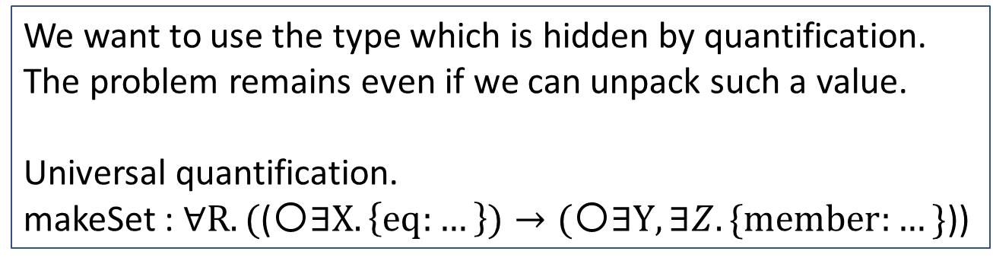
More complexity
let makeSet (type a)
(EqType : (module (EQTYPE with t = a)) code) =
< (module struct
type elt_t = %( EqType.t)
end : SET with elt_t = a) >
$
We want to use the type which is hidden by quantification.
The problem remains even if we can unpack such a value.
Universal quantification.
makeSet : $∀R.($(〇$∃X. \left\{eq:…\right\})→(〇∃Y,∃Z.\{member:…\}$))
Notes:
本研究ではMetaOCamlのようにコード構成子を付加するだけで,
モジュールコードの生成が行えるマルチステージ言語を設計した.
このプログラムは本研で提案するマルチステージ言語を用いて
makeSetの例をモジュール生成器にしたものである.
以下, このようなマルチステージ言語の設計と, ソースコード中の青字で示した
本研究で導入したマルチステージ構成子について説明する.

